Slide 1



Noida Institute of Engineering and Technology, Greater Noida
INTRODUCTION TO MACHINE LEARNING
Unit: 1
MACHINE LEARNING
ACSML0601
Dr. Roop Singh
Associate Professor
CSE(AI) Department
B Tech 6th Sem
Computer Science and Engineering (Artificial Intelligence)

Slide 2
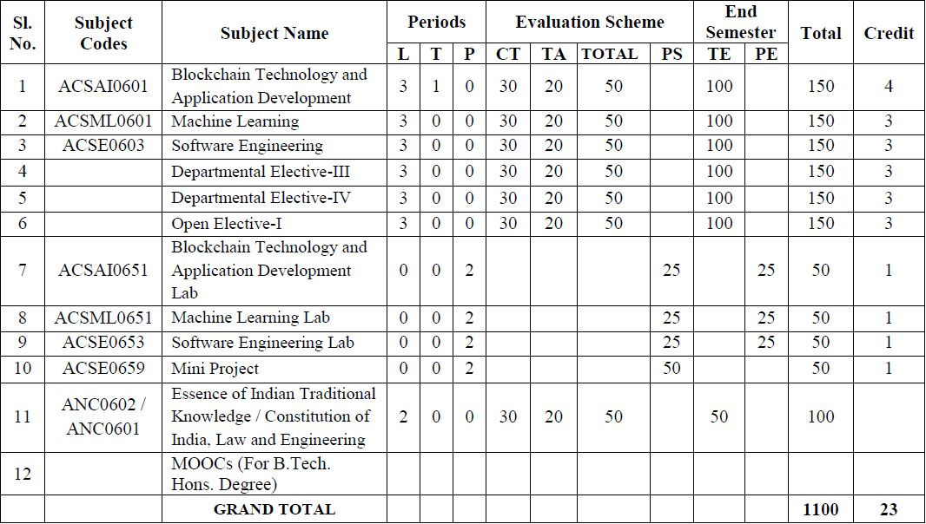
Evaluation Scheme

Slide 3
Subject Syllabus
B. TECH. THIRD YEAR
Course code | ACSML0601 | L T P | Credits
Course title | MACHINE LEARNING | 3 0 0 | 3
Course objective: To introduction to the fundamental concepts in machine learning and popular machine learning algorithms. To understand the standard and most popular supervised learning algorithm.
Pre-requisites: Basic Knowledge of Machine learning.
Course Contents / Syllabus
UNIT-I | INTRODUCTION TO MACHINE LEARNING |  | 8 Hours
INTRODUCTION – Learning, Types of Learning, Well defined learning problems, Designing a Learning System, History of ML, Introduction of Machine Learning Approaches, Introduction to Model Building, Sensitivity Analysis, Underfitting and Overfitting, Bias and Variance, Concept Learning Task, Find – S Algorithms, Version Space and Candidate Elimination Algorithm, Inductive Bias, Issues in Machine Learning and Data Science Vs Machine Learning.
UNIT-II | MINING ASSOCIATION AND SUPERVISED LEARNING |  | 8 Hours
Classification and Regression, Regression: Linear Regression, Multiple Linear Regression, Logistic Regression, Polynomial Regression, Decision Trees: ID3, C4.5, CART. Apriori Algorithm: Market basket analysis, Association Rules. Neural Networks: Introduction, Perceptron, Multilayer Perceptron, Support vector machine.
UNIT-III | UNSUPERVISED LEARNING |  | 8 Hours
Introduction to clustering, K-means clustering, K-Nearest Neighbor, Iterative distance-based clustering, Dealing with continuous, categorical values in K-Means, Hierarchical: AGNES, DIANA, Partitional: K-means clustering, K-Mode Clustering, density-based clustering, Expectation Maximization, Gaussian Mixture Models.

Slide 4
Subject Syllabus
UNIT-IV | PROBABILISTIC LEARNING & ENSEMBLE | 8 Hours
Bayesian Learning, Bayes Optimal Classifier, Naıve Bayes Classifier, Bayesian Belief Networks. Ensembles methods: Bagging & boosting, C5.0 boosting, Random Forest, Gradient Boosting Machines and XGBoost.
UNIT-V | REINFORCEMENT LEARNING & CASE STUDIES | 8 Hours
Reinforcement Learning: Introduction to Reinforcement Learning, Learning Task, Example of Reinforcement Learning in Practice, Learning Models for Reinforcement – (Markov Decision process, Q Learning – Q Learning function, QLearning Algorithm), Application of Reinforcement Learning. Case Study: Health Care, E Commerce, Smart Cities.

Slide 5
Text Books
Text books:
Marco Gori , Machine Learning: A Constraint-Based Approach, Morgan Kaufmann. 2017
Ethem Alpaydin, Machine Learning: The New AI, MIT Press-2016
Bishop, Christopher. Neural Networks for Pattern Recognition. New York, NY: Oxford University Press, 1995
Tom M. Mitchell, “Machine Learning”, McGraw-Hill, 2010
Reference Books:
Ryszard, S., Michalski, J. G. Carbonell and Tom M. Mitchell, Machine Learning: An Artificial Intelligence Approach, Volume 1, Elsevier. 2014
Stephen Marsland, Taylor & Francis 2009. Machine Learning: An Algorithmic Perspective.
Ethem Alpaydin, (2004) “Introduction to Machine Learning (Adaptive Computation and Machine Learning)”, The MIT Press.
Fundamentals of Machine Learning for Predictive Data Anayltics: Algorithms, Worked Examples, and Case Studies 1st Edition by John D. Kelleher

Slide 6
Branch Wise Applications

Slide 7
Course Objective
To introduce students to the basic concepts of Machine Learning.
To develop skills of implementing machine learning for solving practical problems.
To gain experience of doing independent study and research related to Machine Learning

Slide 8
Course Outcome
At the end of the semester, student will be able to:
Course Outcomes (CO) | CO Description | Blooms’ Taxonomy
CO1 | Understanding utilization and implementation proper machine learning algorithm. | K2
CO2 | Understand the basic supervised machine learning algorithms. | K2
CO3 | Understand the difference between supervise and unsupervised learning. | K2
CO4 | Understand algorithmic topics of machine learning and mathematically deep enough to introduce the required theory. | K2
CO5 | Apply an appreciation for what is involved in learning from data. | K3

Slide 9
Program Outcome
1. Engineering knowledge:
2. Problem analysis:
3. Design/development of solutions:
4. Conduct investigations of complex problems:
5. Modern tool usage:
6. The engineer and society:
7. Environment and sustainability:
8. Ethics:
9. Individual and team work:
10. Communication:
11. Project management and finance:
12. Life-long learning

Slide 10
CO-PO and PSO Mapping
Correlation Matrix of CO with PO
CO.K | PO1 | PO2 | PO3 | PO4 | PO5 | PO6 | PO7 | PO8 | PO9 | PO10 | PO11 | PO12
ACSML0601.1 | 3 | 2 | 2 | 1 | 2 | 2 | - | - | - | 1 | - | -
ACSML0601.2 | 3 | 2 | 2 | 3 | 2 | 2 | 1 | - | 2 | 1 | 1 | 2
ACSML0601.3 | 2 | 2 | 2 | 2 | 2 | 2 | 2 | 1 | 1 | - | 1 | 3
ACSML0601.4 | 3 | 3 | 1 | 3 | 1 | 1 | 2 | - | 2 | 1 | 1 | 2
ACSML0601.5 | 3 | 2 | 1 | 2 | 1 | 2 | 1 | 1 | 2 | 1 | 1 | 1
AVG | 2.8 | 2.2 | 1.6 | 2.2 | 1.6 | 1.8 | 1.2 | 0.4 | 1.4 | 0.8 | 0.8 | 1.6

Slide 11
Program Specific Outcomes
PSO1-Apply Artificial Intelligence and its applications to design intelligent systems for the betterment of society.
PSO2-Develop AI-based innovative solutions demonstrating research, entrepreneurship, professional ethics, and communication skills.
PSO3-Demonstrate competency in AI by working in a team and engaging in life-long learning.

Slide 12
CO-PO and PSO Mapping
Matrix of CO/PSO:
 | PSO1 | PSO2 | PSO3
ACSML0601.1 | 3 | 2 | 3
ACSML0601.2 | 3 | 2 | 2
ACSML0601.3 | 3 | 2 | 3
ACSML0601.4 | 2 | 1 | 1
ACSML0601.5 | 2 | 2 | 1
AVG | 2.6 | 1.8 | 2

Slide 13
Program Educational Objectives
PEO1-Engage in successful professional practices in the area of Artificial Intelligence and pursue higher education and research.
PEO2-Demonstrate effective leadership and communicate as an individual and as a team in the workspace and society.
PEO3-Pursue life-long learning in developing AI-based innovative solutions for the betterment of society.

Slide 14
Result Analysis
ML Result of 2020-21: 89.39%
Average Marks: 46.05

Slide 15
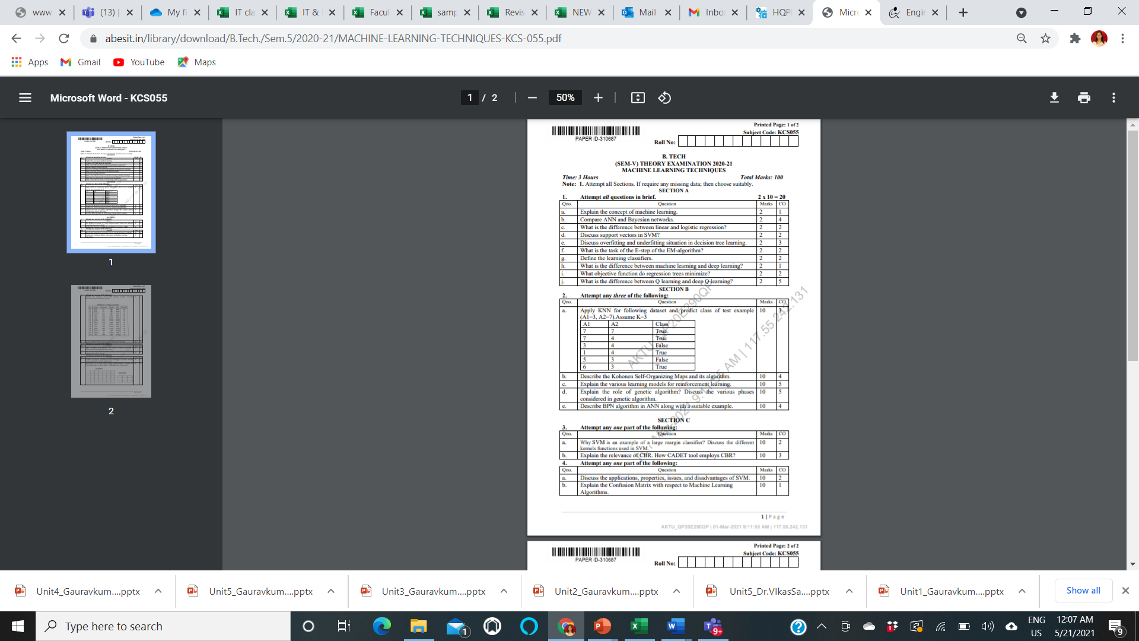
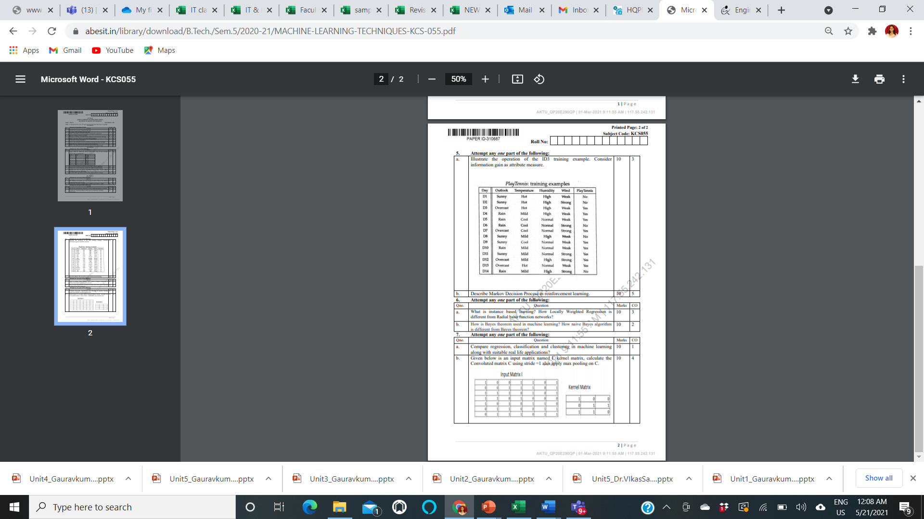
End Semester Question Paper Template

Slide 16
Prerequisite
Prerequisites:
Statistics.
Linear Algebra.
Calculus.
Probability.
Programming Languages.

Slide 17
Brief Introduction to Subject
https://www.youtube.com/watch?v=PPLop4L2eGk&list=PLLssT5z_DsK-h9vYZkQkYNWcItqhlRJLN

Slide 18
Topic Mapping with Course Outcome
Topics | Course outcome
Learning, Types of Learning, Well defined learning problems. Designing a Learning System. Concept Learning Introduction of Machine Learning Approaches –Issues in Machine Learning. Data Science Vs Machine Learning; | CO1 CO1 CO1 CO1 CO1

Slide 19
Lecture Plan

Slide 20
Lecture Plan

Slide 21
Lecture Plan

Slide 22
Lecture Plan

Slide 23
Lecture Plan

Slide 24
Unit 1 Content:
INTRODUCTION – Learning,
Types of Learning,
Well defined learning problems,
Designing a Learning System,
History of ML,
Introduction of Machine Learning Approaches,
Introduction to Model Building,
Sensitivity Analysis,
Underfitting and Overfitting,
Bias and Variance,
Concept Learning Task,
Issues in Machine Learning and Data Science Vs Machine Learning.

Slide 25

Unit Objective
The objective of the Unit 1:
1. To understand the basics of machine learning.
2. A clear concept of Learning and learning systems.
3. Brief History of ML.
4. Use of various approaches of Machine learning.
5. understand the difference between Data Science and Machine learning.

Slide 26
Topic Objective
Student will be able to understand
Learning
Types of Learning,
Well defined learning problems,
Designing a Learning System

Slide 27
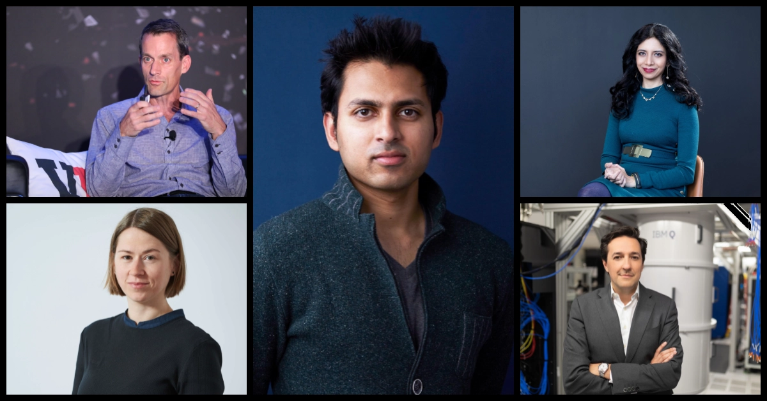
Introduction (CO1)
Top minds in machine learning predict where AI is going in 2021 and Beyond
AI is no longer poised to change the world someday; it’s changing the world now.

Slide 28

Introduction (CO1)
Soumith Chintala
Director, principal engineer, and creator of PyTorch
“I actually don’t think we’ve had a groundbreaking thing … since Transformer, basically. We had ConvNets in 2012 that reached prime time, and Transformer in 2017 or something. That’s my personal opinion,”
Chintala also believes the evolution of machine learning frameworks like PyTorch and Google’s TensorFlow — the overwhelming favorites among ML practitioners today — have changed how researchers explore ideas and do their jobs.

Slide 29
Introduction (CO1)
Soumith Chintala
Director, principal engineer, and creator of PyTorch
Depending on how you gauge it, PyTorch is the most popular machine learning framework in the world today.
A derivative of the Torch open source framework introduced in 2002, PyTorch became available in 2015 and is growing steadily in extensions and libraries.

Slide 30

Introduction (CO1)
Celeste Kidd
Developmental psychologist at the
University of California, Berkeley
Celeste Kidd is director of Kidd Lab at the University of California, Berkeley, where she and her team explore how kids learn.
“Human babies don’t get tagged data sets, yet they manage just fine, and it’s important for us to understand how that happens,” she said.
Last month, Kidd delivered the opening keynote address at the Neural Information Processing Systems (NeurIPS) conference, the largest annual AI research conference in the world. Her talk focused on how human brains hold onto stubborn beliefs, attention systems, and Bayesian statistics.

Slide 31
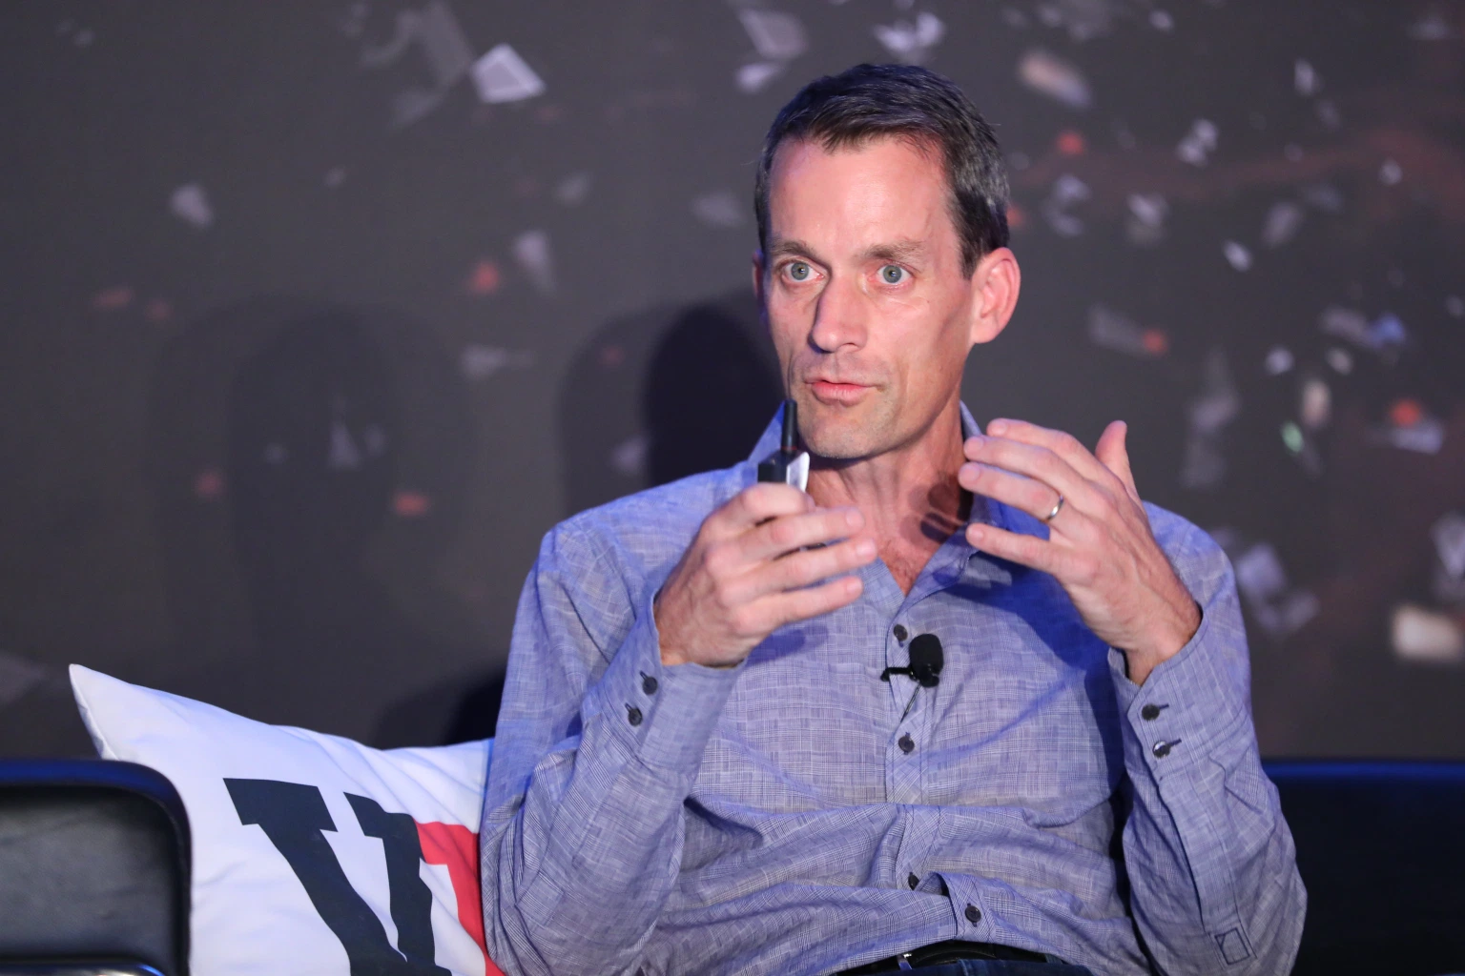
Introduction (CO1)
Jeff Dean
Google AI chief
Dean has led Google AI for nearly two years now, but he’s been at Google for two decades and is the architect of many of the company’s early search and distributed network algorithms and an early member of Google Brain.
Dean spoke with VentureBeat last month at NeurIPS, where he delivered talks on machine learning for ASIC semiconductor design and ways the AI community can address climate change, which he said is the most important issue of our time. In his talk about climate change, Dean discussed the idea that AI can strive to become a zero-carbon industry and that AI can be used to help change human behavior.

Slide 32

Introduction (CO1)
Anima Anandkumar
Nvidia machine learning research director
Anandkumar sees numerous challenges for the AI community in 2020, like the need to create models made especially for specific industries in tandem with domain experts. Policymakers, individuals, and the AI community will also need to grapple with issues of representation and the challenge of ensuring data sets used to train models account for different groups of people.

Slide 33
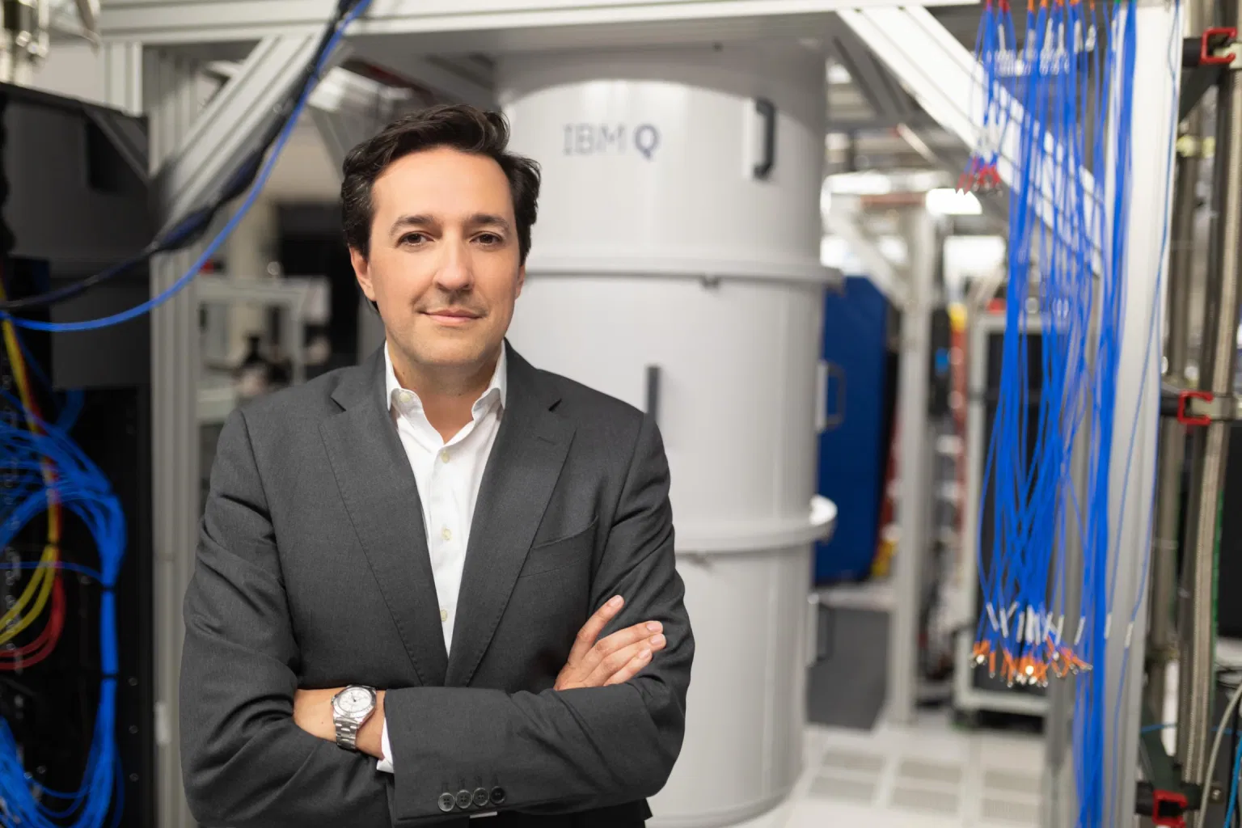
Introduction (CO1)
Dario Gil
IBM Research director
Gil heads a group of researchers actively advising the White House and enterprises around the world. He believes major leaps forward in 2019 include progress around generative models and the increasing quality with which plausible language can be generated.

Slide 34
Introduction (CO1)
What industry is looking ?
Advances in natural language models were a major story of 2019 as Transformers fueled great leaps forward. Look for more variations of BERT and Transformer-based models in 2021.
The AI industry should look for ways to value model outputs beyond accuracy.
Methods like semi-supervised learning, a neural symbolic approach to machine learning, and subfields like multitask and multimodal learning may progress in the year ahead.
Ethical challenges related to biometric data like speech recordings will likely continue to be controversial.
Compilers and approaches like quantization may grow in popularity for machine learning frameworks like PyTorch and TensorFlow as ways to optimize model performance.

Slide 35
Introduction (CO1)

Slide 36
Introduction (CO1)

Slide 37
Introduction (CO1)

Slide 38
Introduction (CO1)

Slide 39
Introduction (CO1)

Slide 40
Introduction (CO1)

Slide 41
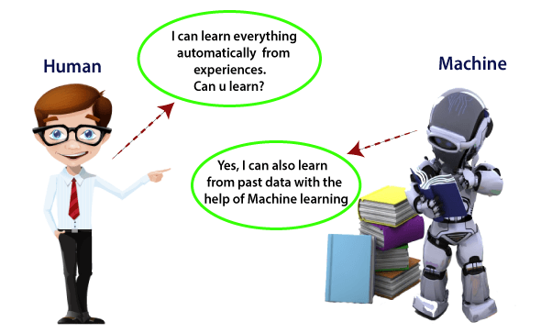
Introduction to ML (CO1)
What is Machine Learning

Slide 42
Introduction (CO1)

Slide 43
Introduction (CO1)

Slide 44
Introduction (CO1)

Slide 45
Introduction (CO1)

Slide 46
Introduction (CO1)

Slide 47
Introduction (CO1)

Slide 48
Introduction (CO1)

Slide 49
Introduction (CO1)

Slide 50
Introduction (CO1)

Slide 51
Introduction (CO1)

Slide 52
Introduction (CO1)

Slide 53
Introduction (CO1)

Slide 54
Introduction (CO1)

Slide 55
Introduction (CO1)

Slide 56
Introduction (CO1)

Slide 57
Introduction (CO1)

Slide 58
Introduction (CO1)

Slide 59
Introduction (CO1)

Slide 60
Introduction (CO1)

Slide 61
Introduction (CO1)

Slide 62
Introduction (CO1)

Slide 63
Introduction (CO1)

Slide 64
Introduction (CO1)

Slide 65
Introduction (CO1)

Slide 66
Introduction (CO1)

Slide 67
Introduction (CO1)

Slide 68
Introduction (CO1)

Slide 69
Introduction (CO1)

Slide 70
Introduction (CO1)

Slide 71
Introduction (CO1)

Slide 72
Introduction (CO1)

Slide 73
Introduction (CO1)

Slide 74
Introduction (CO1)

Slide 75
Introduction (CO1)

Slide 76
Introduction (CO1)

Slide 77
Introduction (CO1)

Slide 78
Introduction (CO1)

Slide 79
Introduction (CO1)

Slide 80
Introduction (CO1)

Slide 81
Introduction (CO1)

Slide 82
Introduction (CO1)

Slide 83
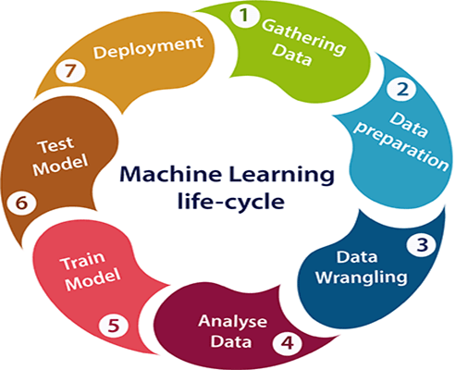
Introduction (CO1)

Slide 84
Introduction (CO1)

Slide 85
Introduction (CO1)

Slide 86
Introduction (CO1)

Slide 87
Introduction (CO1)

Slide 88
Introduction (CO1)

Slide 89
Learning (CO1,2,3,4)

Slide 90
Learning (CO1,2,3,4)
Learning:
The acquisition of knowledge or skills through study, experience, or being taught.
Children learn by watching and imitating the people around them.
Psychologists call this observational learning. And they learn by listening to what other people say about how the world works—what psychologists call learning from testimony. (Gopnik 2016: 89)

Slide 91
Learning (CO1,2,3,4)
Well Posed Learning Problem:
Definition: A computer program is said to learn from experience E with respect to some class of tasks T and performance measure P, if its performance at tasks in T, as measured by P, improves with experience E.
For example, a computer program that learns to play checkers might improve its performance as measured by its ability to win at the class of tasks involving playing checkers games, through experience obtained by playing games against itself.

Slide 92
Learning (CO1,2,3,4)

Slide 93
Learning (CO1,2,3,4)
A checkers learning problem:
Task T: playing checkers
Performance measure P: percent of games won against opponents
Training experience E: playing practice games against itself

Slide 94
Learning (CO1,2,3,4)
A handwriting recognition learning problem:
Task T: recognizing and classifying handwritten words within images
Performance measure P: percent of words correctly classified
Training experience E: a database of handwritten words with given classifications

Slide 95
Learning (CO1,2,3,4)
A robot driving learning problem:
Task T: driving on public four-lane highways using vision sensors
Performance measure P: average distance traveled before an error (as judged by human overseer)
Training experience E: a sequence of images and steering commands recorded while observing a human driver

Slide 96
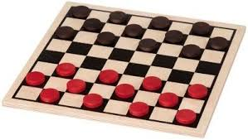
Learning (CO1,2,3,4)

Slide 97
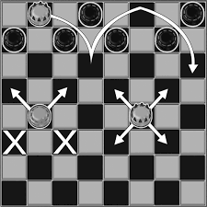
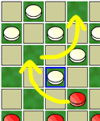
Learning (CO1,2,3,4)

Slide 98
Learning (CO1,2,3,4)

Slide 99
Learning (CO1,2,3,4)
DESIGNING A LEARNING SYSTEM
Choosing the Training Experience:
Choosing the Target Function
Choosing a Representation for the Target Function
Choosing a Function Approximation Algorithm
The Final design

Slide 100
Learning (CO1,2,3,4)
DESIGNING A LEARNING SYSTEM
Choosing the Training Experience:
The first design choice we face is to choose the type of training experience from which our system will learn.
The type of training experience available can have a significant impact on success or failure of the learner.
There are three attributes which impact on success or failure of the learner.
One key attribute is whether the training experience provides direct or indirect feedback regarding the choices made by the performance system.
A second important attribute of the training experience is the degree to which the learner controls the sequence of training examples.
A third important attribute of the training experience is how well it represents the distribution of examples over which the final system performance P must be measured.

Slide 101
Learning (CO1,2,3,4)
One key attribute is whether the training experience provides direct or indirect feedback regarding the choices made by the performance system.
EXAMPLE:
Checkers system learning from:
Direct Training:
Database example consisting of individual checkers board states and the correct move for each.
Indirect Training:
Database of examples consisting of moves sequences and final outcomes of the game played.

Slide 102
Learning (CO1,2,3,4)

Slide 103
Learning (CO1,2,3,4)
The learner faces an additional problem of credit assignment.
Where each move in the sequence deserves credit or blame for the final out come.
Credit assignment can be problem:
Because the game can be lost even when early moves are optimal if these are followed by poor moves.
Hence the direct training is easier then learning from the indirect.

Slide 104
Learning (CO1,2,3,4)

Slide 105
Learning (CO1,2,3,4)
2. A second attribute of the training experience is the degree to
which learner controls the sequence of examples.
EXAMPLES:
Teacher to select information base states and provide the correct move for each. This is passed down to learner. Teacher to Learner.
Learner might itself propose board state that it finds particularly confusing and ask the teacher for the correct move. Learner to Teacher.
Learner might have complete control over both the board states and indirect training and finds solution to itself. Teacher not required.
Learner may choose between experimenting with novel based states it is not yet considered. Learner experiments with changes.

Slide 106
Learning (CO1,2,3,4)
3. The third attribute of the training experience is how well it represents the distribution of examples over which the final system performance P must be measured.
Learning is most reliable when the training examples follow a distribution similar to that of future test examples.
In checkers learning scenario the performance matrix P is the percent of games the system within world tournament.
If the training experience is done only games played to itself the problem is the experience is not distributed to the unexpected situation.
Unexpected situation like: There are different checker champion with different board states or moves.

Slide 107
Learning (CO1,2,3,4)
A checkers learning problem:
Task T: playing checkers
Performance measure P: percent of games won in the world tournament
Training experience E: games played against itself
In order to complete the design of the learning system, we must now choose
1. the exact type of knowledge to be, learned
2. a representation for this target knowledge
3. a learning mechanism
(For learning to play checkers watch the video
https://www.youtube.com/watch?v=m0drB0cx8pQ )

Slide 108
Learning (CO1,2,3,4)
2. Choosing the Target Function:
The next design choice is to determine exactly what type of knowledge will be learned and how this will be used by the performance of a program.
Let us begin with a checkers-playing program that can generate the legal moves from any board state.
The program needs only to learn how to choose the best move from among these legal moves.
Priori: Legal moves that define large space or best results at the long stretch is called priori.

Slide 109
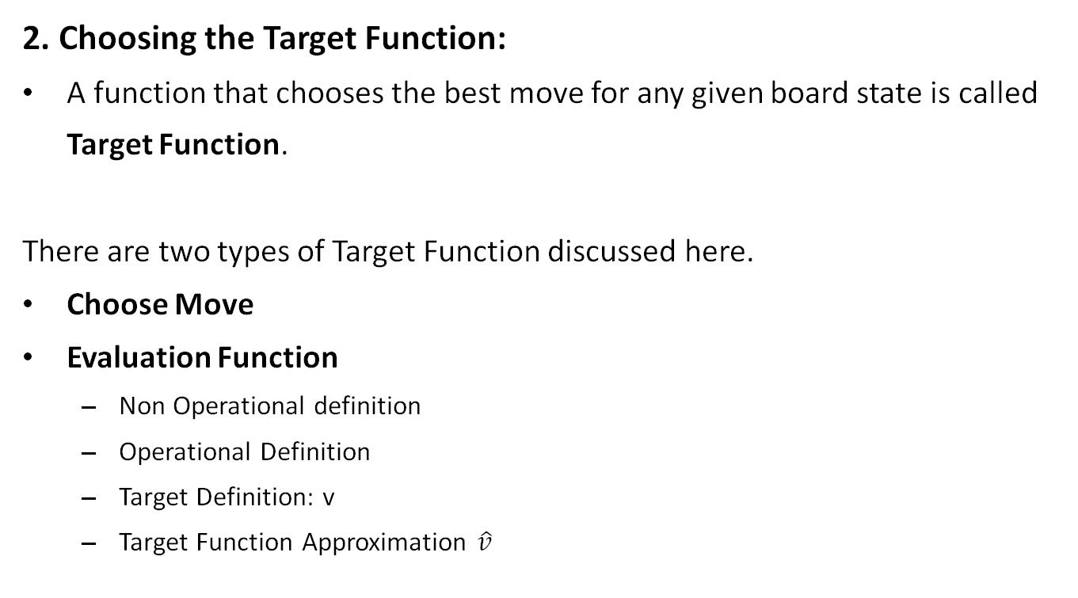
Learning (CO1,2,3,4)
2. Choosing the Target Function:
A function that chooses the best move for any given board state is called Target Function.
There are two types of Target Function discussed here.
Choose Move
Evaluation Function
Non Operational definition
Operational Definition
Target Definition: v
Target Function Approximation $\hat{v}$

Slide 110
Learning (CO1,2,3,4)
Choose Move Target Function:
Choose move is represented as target function
ChooseMove: B→M
This accepts as input of board from the set of legal board states B
Produces as output some move from the set of legal move M.

Slide 111
Learning (CO1,2,3,4)
Choose Move Target Function:
Choose Move Drawback:
Choose move target function will turn out to be very difficult to learn when indirect training experience is available in the system.

Slide 112
Learning (CO1,2,3,4)
2. Choosing the Target Function:
Evaluation Target Function:
Assigns a numerical score to any given bard state.
Target Function V
Notion V: B→R
V maps to any legal board state from the set B to some real value.
If R is higher better results.

Slide 113
Move 1: 1(M),(R)
Move 2(Opponent Cut): 5
Move3: (yourself Cut): -5
F(x)= M1+M2+M3+M4…….
F(x) = V(b’)

Slide 114
Learning (CO1,2,3,4)
Possible Definition for Target Function V:
Let us therefore define the target value V(b) for an arbitrary board state b in B, as follows:
if b is a final board state that is won, then V(b) = 100
if b is a final board state that is lost, then V(b) = -100
if b is a final board state that is drawn, then V(b) = 0
if b is a not a final state in the game, then V(b) = V(b’), where b’ is the best final board state that can be achieved starting from b and playing optimally until the end of the game (assuming the opponent plays optimally, as well).

Slide 115
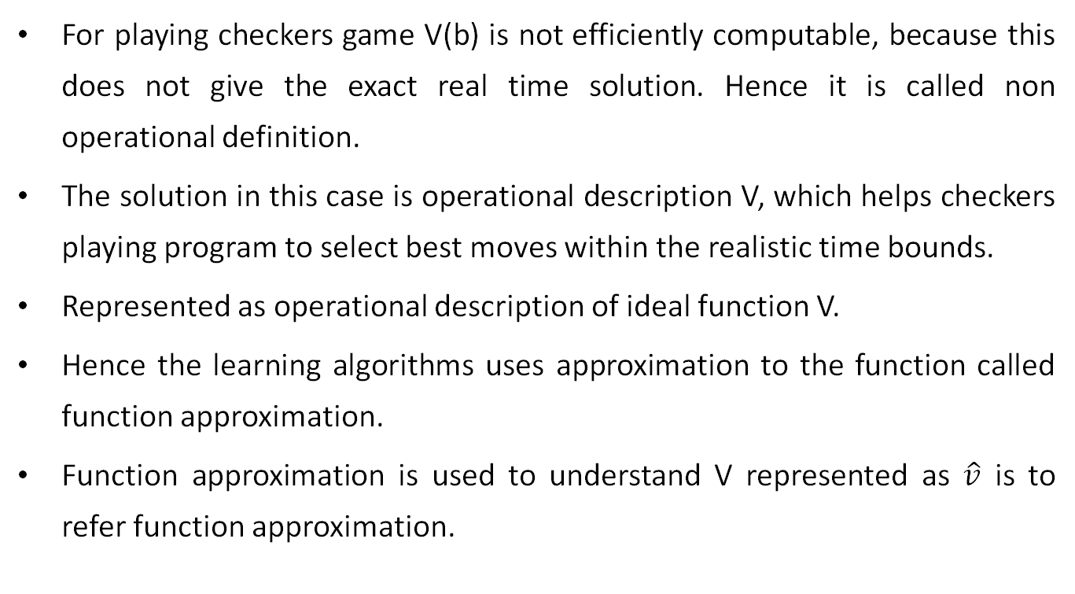
Learning (CO1,2,3,4)
For playing checkers game V(b) is not efficiently computable, because this does not give the exact real time solution. Hence it is called non operational definition.
The solution in this case is operational description V, which helps checkers playing program to select best moves within the realistic time bounds.
Represented as operational description of ideal function V.
Hence the learning algorithms uses approximation to the function called function approximation.
Function approximation is used to understand V represented as $\hat{v}$ is to refer function approximation.

Slide 116
Learning (CO1,2,3,4)
3. Choosing a Representation for the Target Function:
let us choose a simple representation for any given board state, the function v(b) will be calculated as a linear combination of the following board features:
X1: the number of black pieces on the board
X2: the number of red pieces on the board
X3: the number of black kings on the board
X4: the number of red kings on the board
X5: the number of black pieces threatened by red (i.e., which can be captured on red's next turn)
X6: the number of red pieces threatened by black

Slide 117
Learning (CO1,2,3,4)
Thus, our learning program will represent v(b) as a linear function of the form:
where W0 through W6 are numerical coefficients, or weights, to be chosen by the learning algorithm.
Learned values for the weights W1 through W6 will determine the relative importance of the various board features in determining the value of the board, whereas the weight wo will provide an additive constant to the board value.

Slide 118
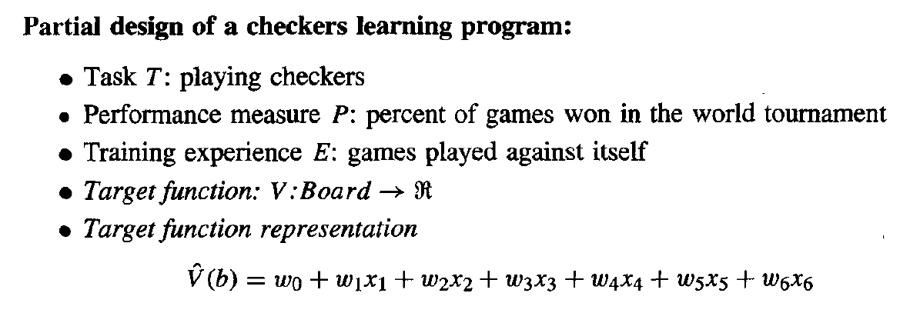
Design a Learning system

Slide 119
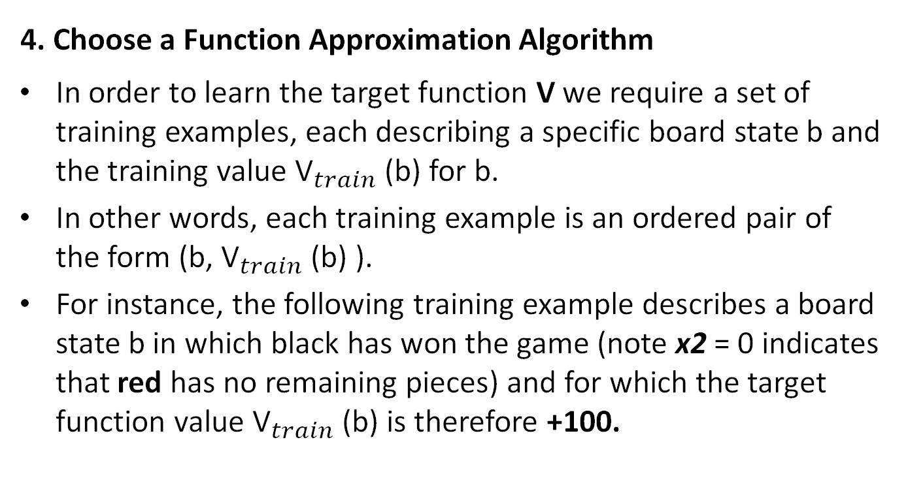
Learning (CO1,2,3,4)
4. Choose a Function Approximation Algorithm
In order to learn the target function V we require a set of training examples, each describing a specific board state b and the training value ${\text{V}}_{train}$(b) for b.
In other words, each training example is an ordered pair of the form (b, ${\text{V}}_{train}$(b) ).
For instance, the following training example describes a board state b in which black has won the game (note x2 = 0 indicates that red has no remaining pieces) and for which the target function value ${\text{V}}_{train}$(b) is therefore +100.

Slide 120
Learning (CO1,2,3,4)
4. Choose a Function Approximation Algorithm
Estimating Training Values:
Adjusting The Weights:
Estimating Training Values:
At present training information only available is about game was won or not.
There is a need of examples which assign specific scores to specific board.

Slide 121
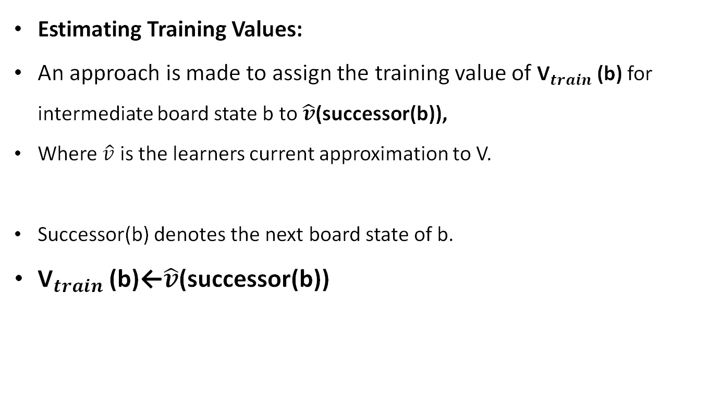
Learning (CO1,2,3,4)
Estimating Training Values:
An approach is made to assign the training value of ${\text{V}}_{train}$(b) for intermediate board state b to $\hat{v}$(successor(b)),
Where $\hat{v}$ is the learners current approximation to V.
Successor(b) denotes the next board state of b.
${\text{V}}_{train}$(b)←$\hat{v}$(successor(b))

Slide 122
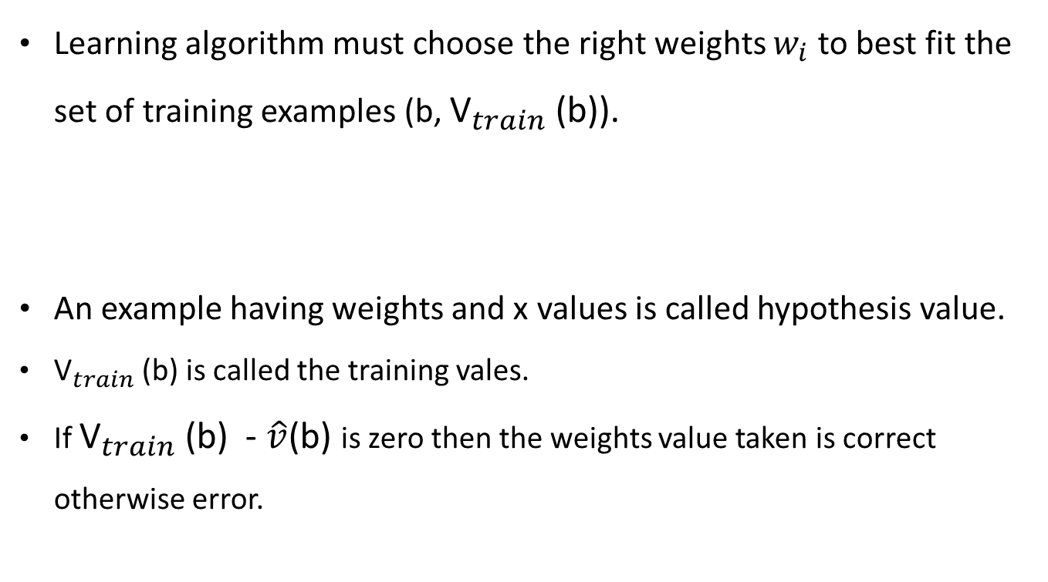
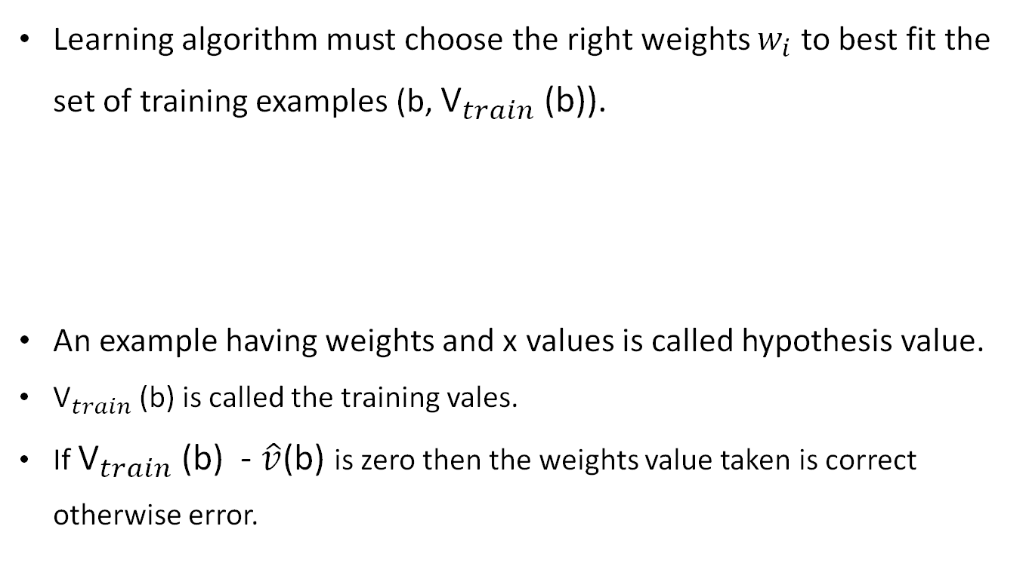
Learning (CO1,2,3,4)
Learning algorithm must choose the right weights $w_{i}$ to best fit the set of training examples (b, ${\text{V}}_{train}$(b)).
An example having weights and x values is called hypothesis value.
${\text{V}}_{train}$(b) is called the training vales.
If ${\text{V}}_{train}$(b) - $\hat{v}$(b) is zero then the weights value taken is correct otherwise error.

Slide 123
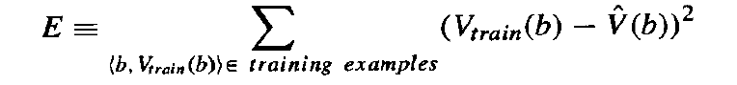
Learning (CO1,2,3,4)
Error E is calculated as:
There are several algorithms are known for finding weights of a linear function that minimizes E.
One such algorithm is least mean square.

Slide 124
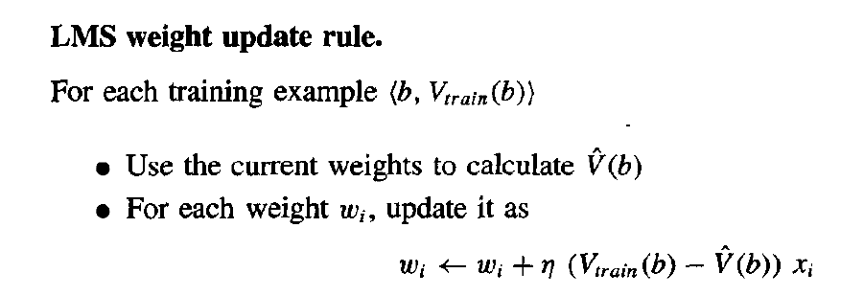
Learning (CO1,2,3,4)
Adjusting the weights:

Slide 125
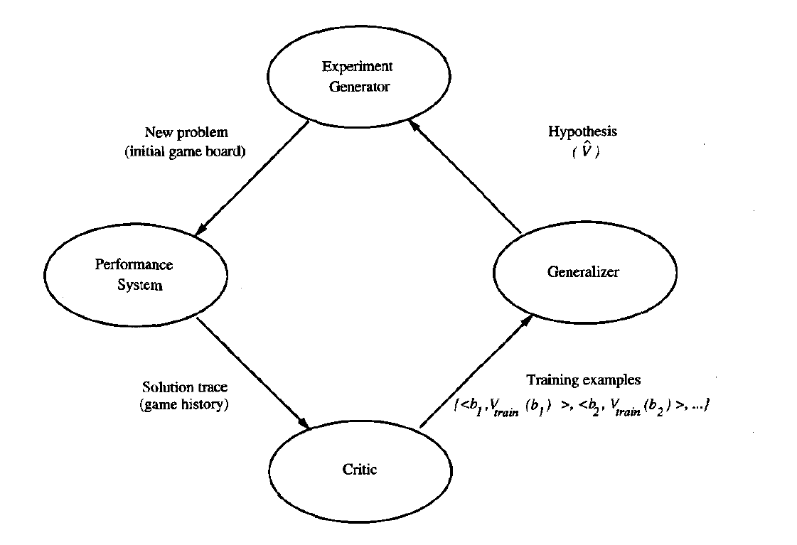
Learning (CO1,2,3,4)
5. The Final Design:

Slide 126
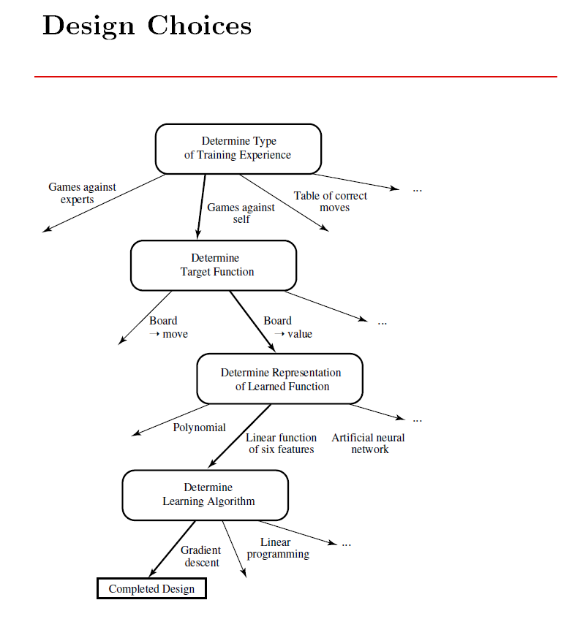
Learning (CO1,2,3,4)

Slide 127
INTRODUCTION
Issues in machine learning
Focusing Too Much on Algorithms and Theories
Mastering ALL of ML
Using Changing or Premade Tools
Having Algorithms Become Obsolete as Soon as Data Grows
Getting Bad Predictions to Come Together With Biases
Making the Wrong Assumptions
Having Bad Data Convert to Bad Results

Slide 128
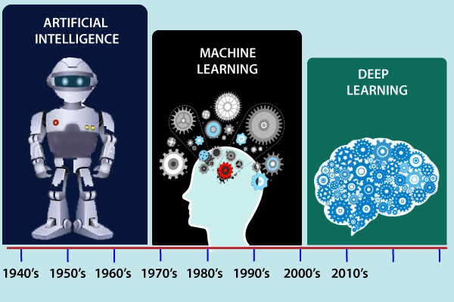
History of Machine Learning (CO1)

Slide 129
History of Machine Learning (CO1)
The early history of Machine Learning (Pre-1940):
1834: In 1834, Charles Babbage, the father of the computer, conceived a device that could be programmed with punch cards. However, the machine was never built, but all modern computers rely on its logical structure.
1936: In 1936, Alan Turing gave a theory that how a machine can determine and execute a set of instructions.
The era of stored program computers:
1940: In 1940, the first manually operated computer, "ENIAC" was invented, which was the first electronic general-purpose computer. After that stored program computer such as EDSAC in 1949 and EDVAC in 1951 were invented.
1943: In 1943, a human neural network was modeled with an electrical circuit. In 1950, the scientists started applying their idea to work and analyzed how human neurons might work.

Slide 130
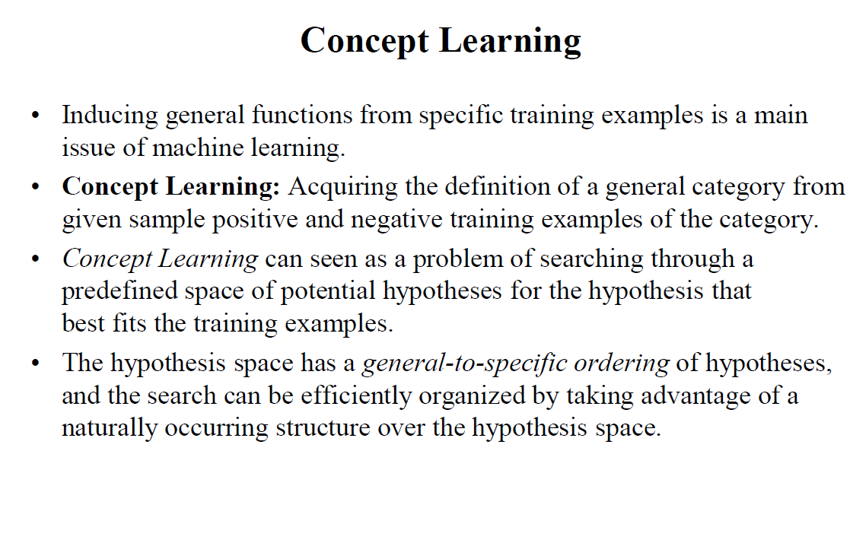
Concept Learning (CO1)

Slide 131
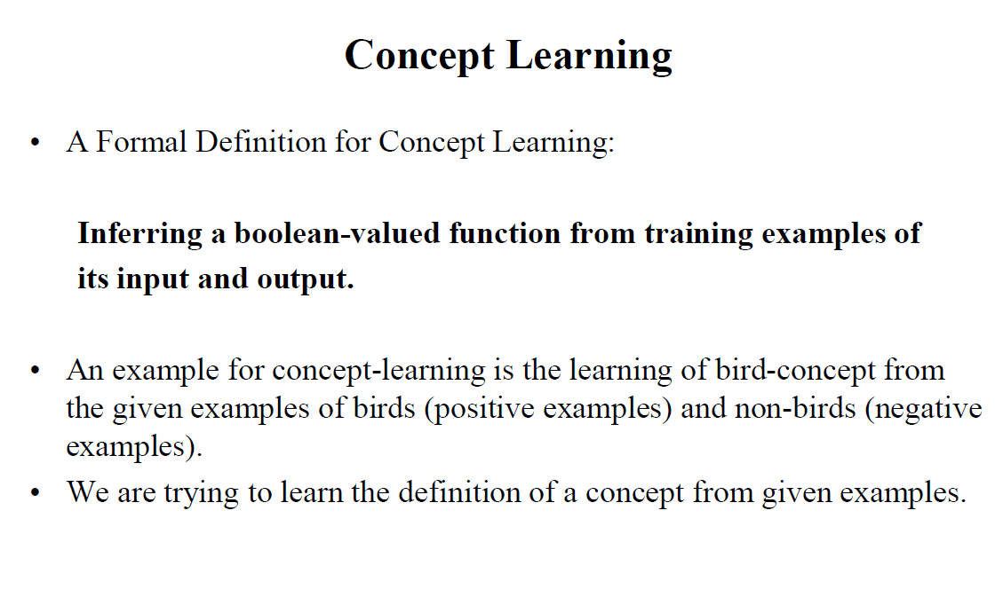
Concept Learning (CO1)

Slide 132
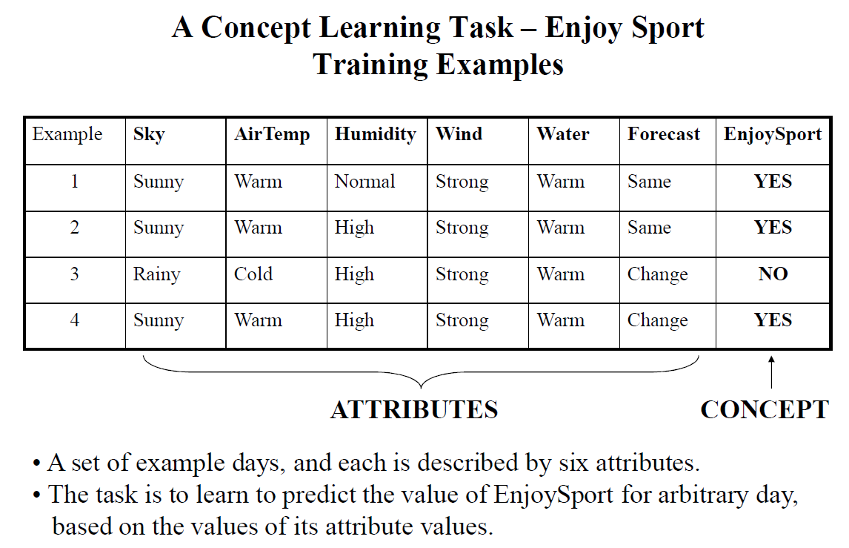
Concept Learning (CO1)

Slide 133
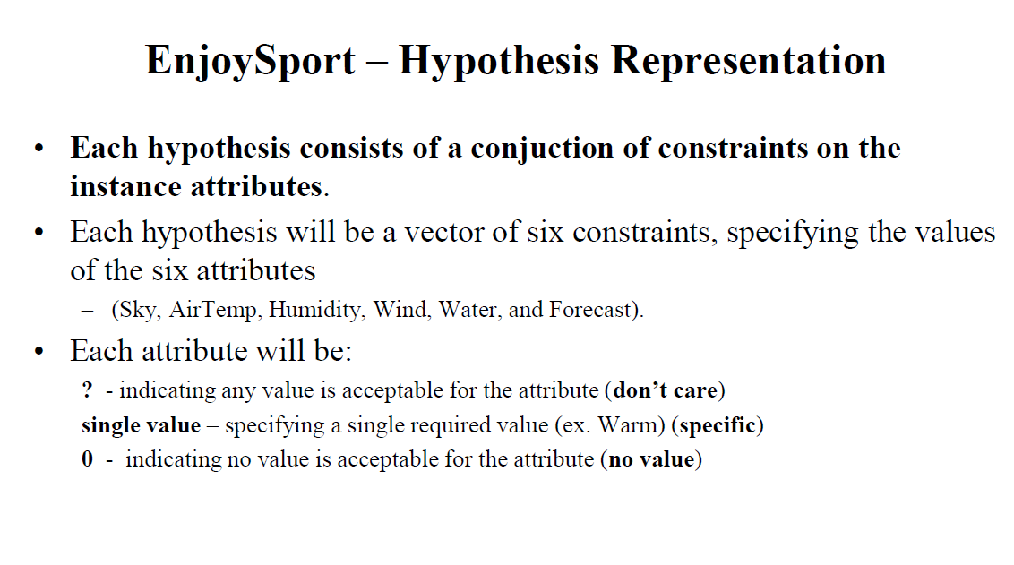
Concept Learning (CO1)

Slide 134
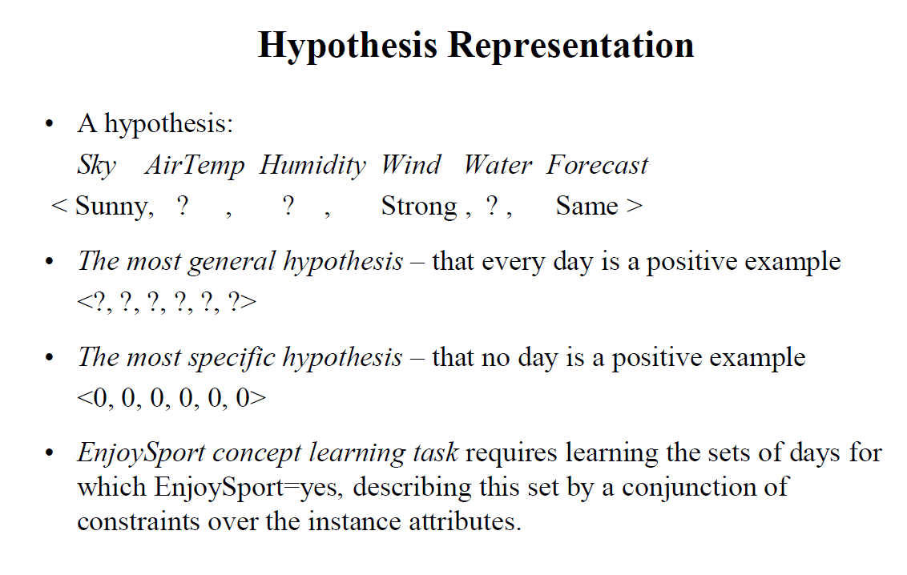
Concept Learning (CO1)

Slide 135
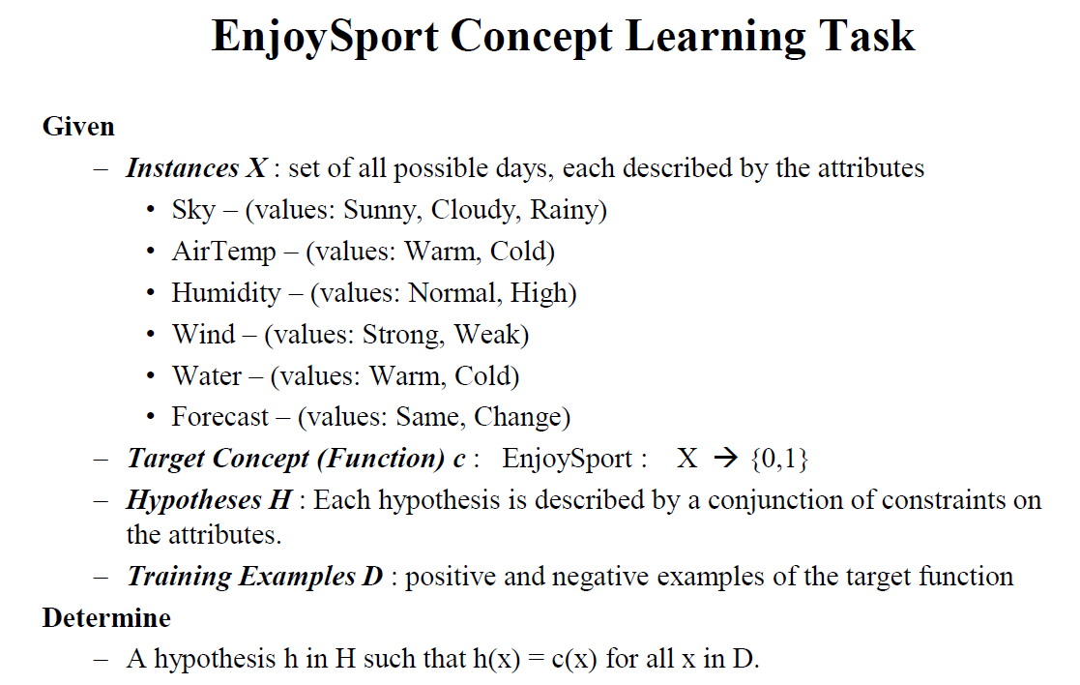
Concept Learning (CO1)

Slide 136
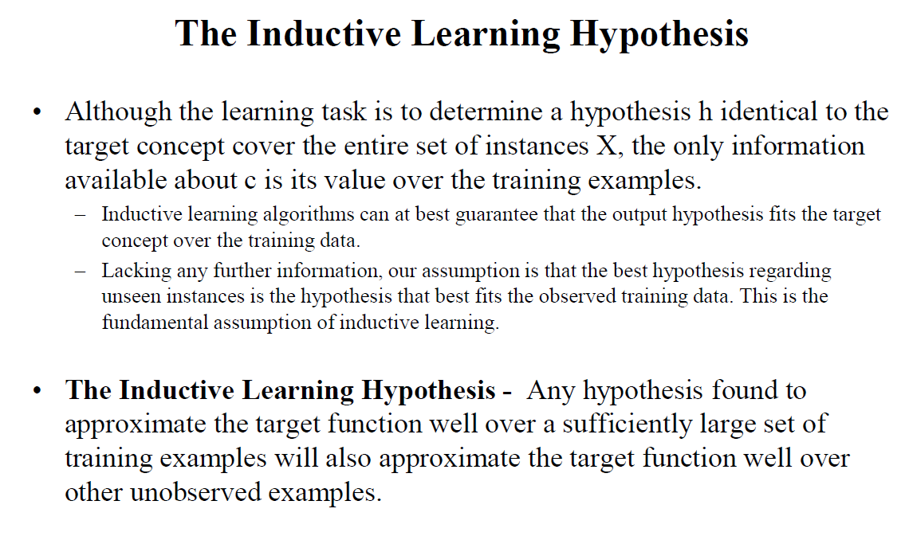
Concept Learning (CO1)

Slide 137
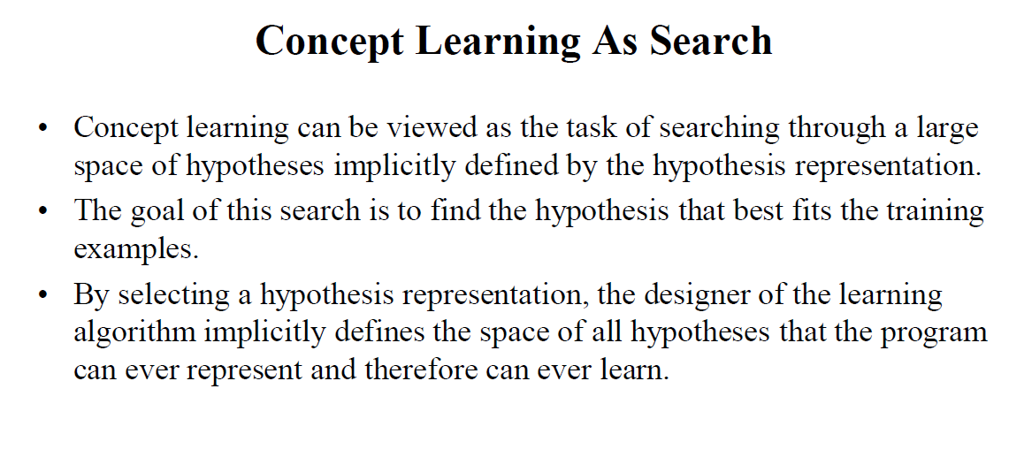
Concept Learning (CO1)

Slide 138
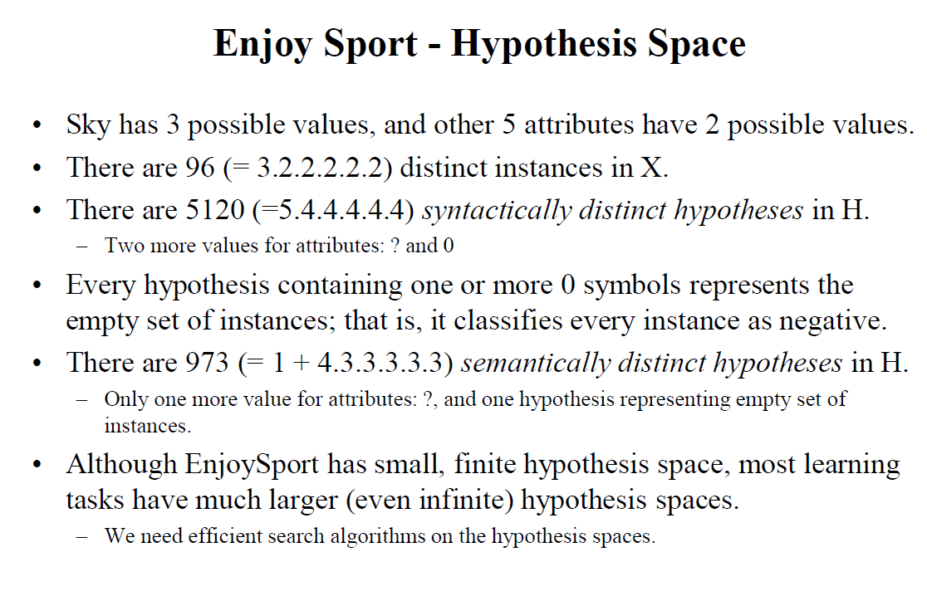
Concept Learning (CO1)

Slide 139
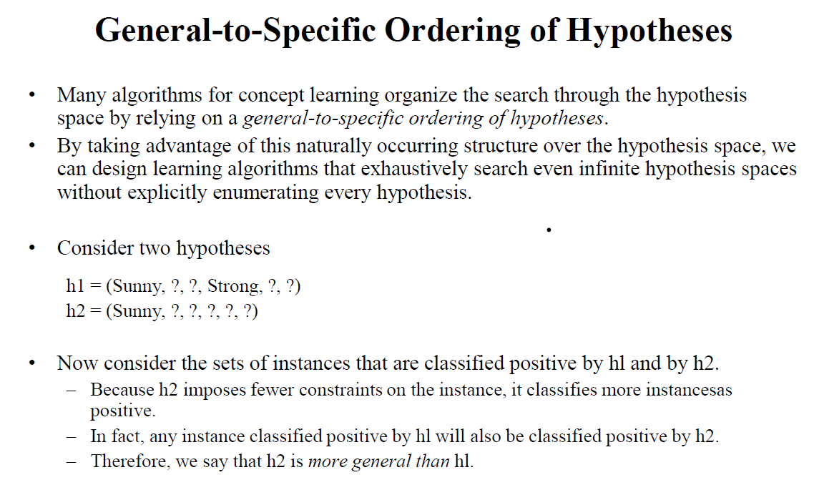
Concept Learning (CO1)

Slide 140
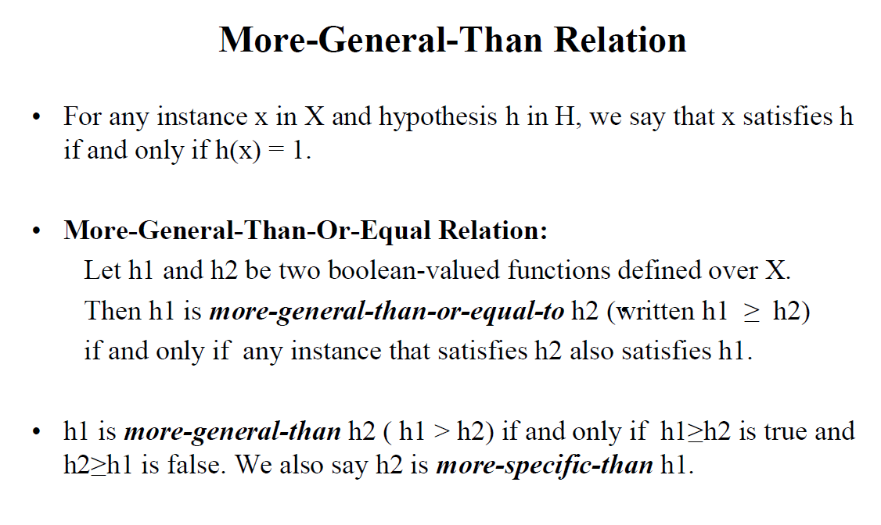
Concept Learning (CO1)

Slide 141
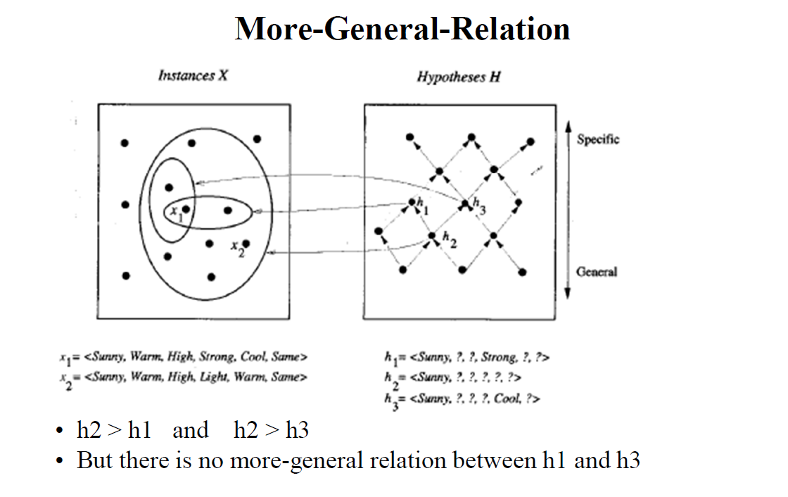
Concept Learning (CO1)

Slide 142
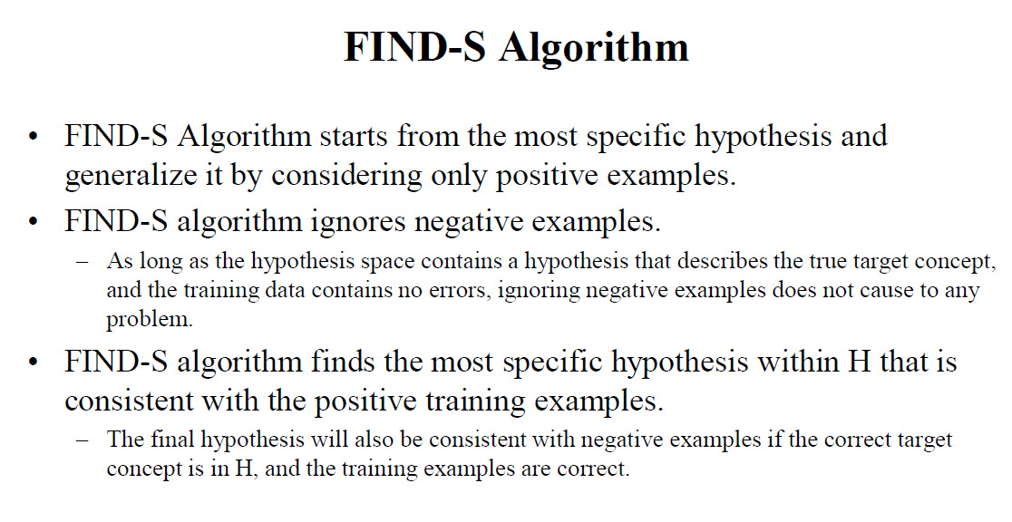
Concept Learning (CO1)

Slide 143
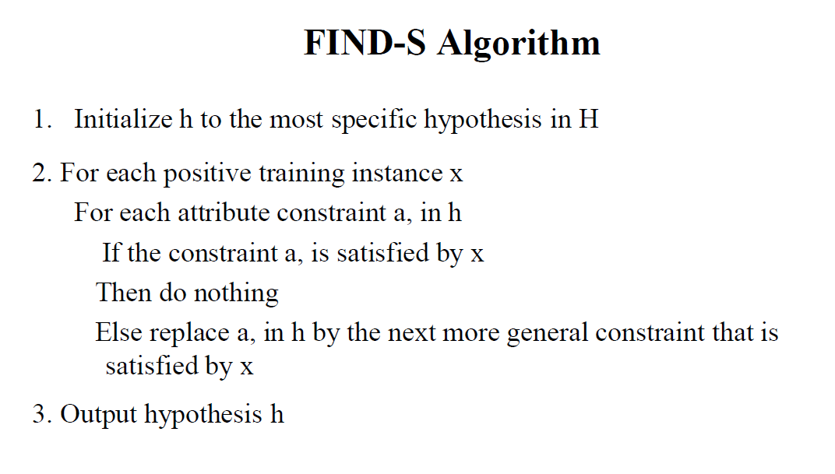
Concept Learning (CO1)

Slide 144
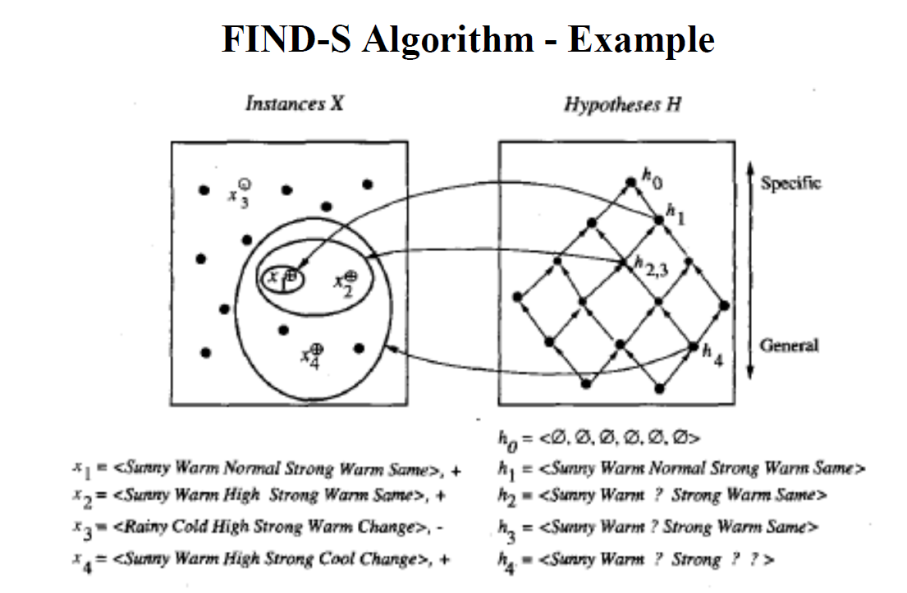
Concept Learning (CO1)

Slide 145
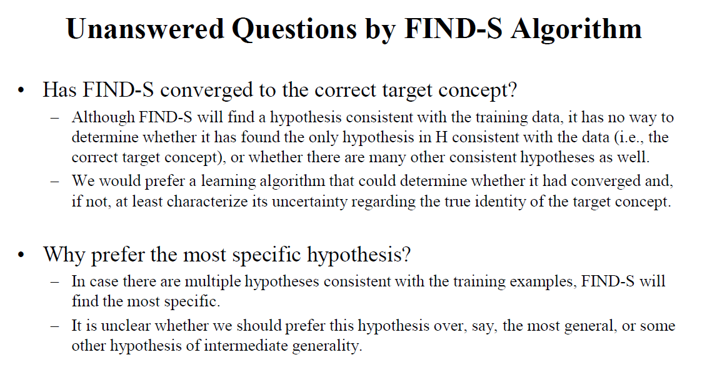
Concept Learning (CO1)

Slide 146
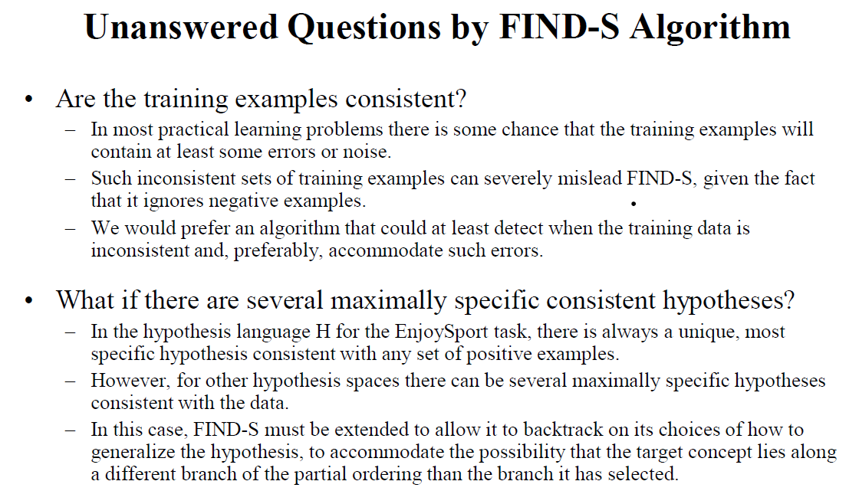
Concept Learning (CO1)

Slide 147
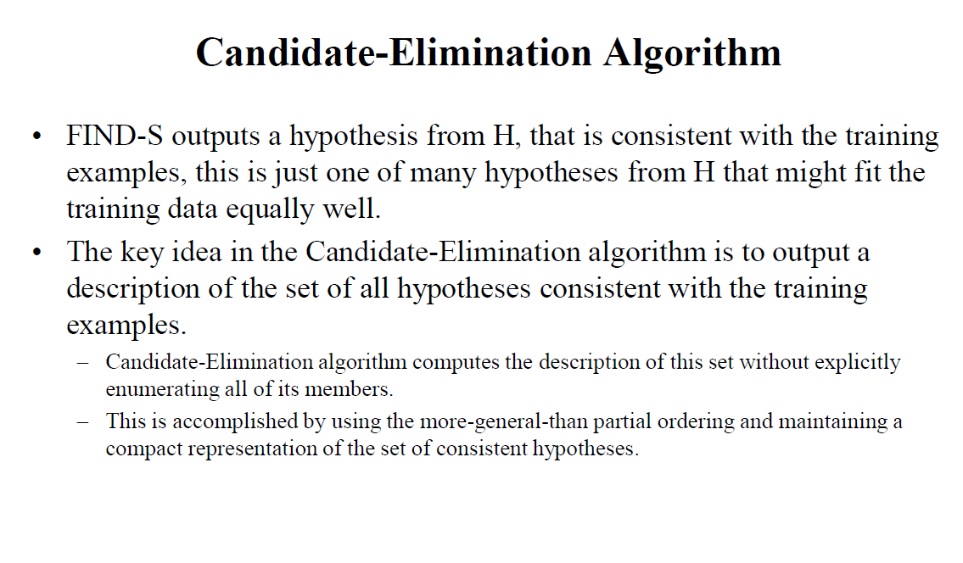
Concept Learning (CO1)

Slide 148
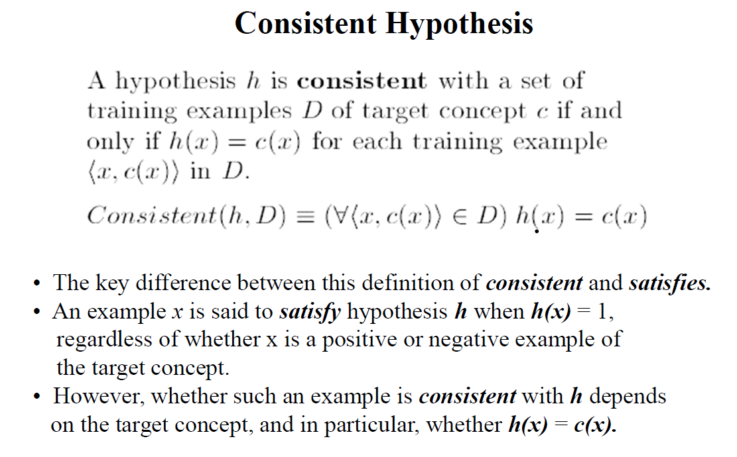
Concept Learning (CO1)

Slide 149
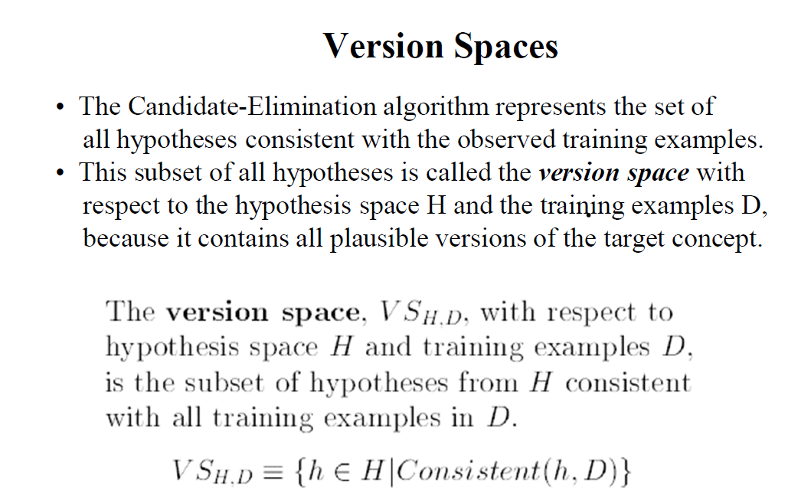
Concept Learning (CO1)

Slide 150
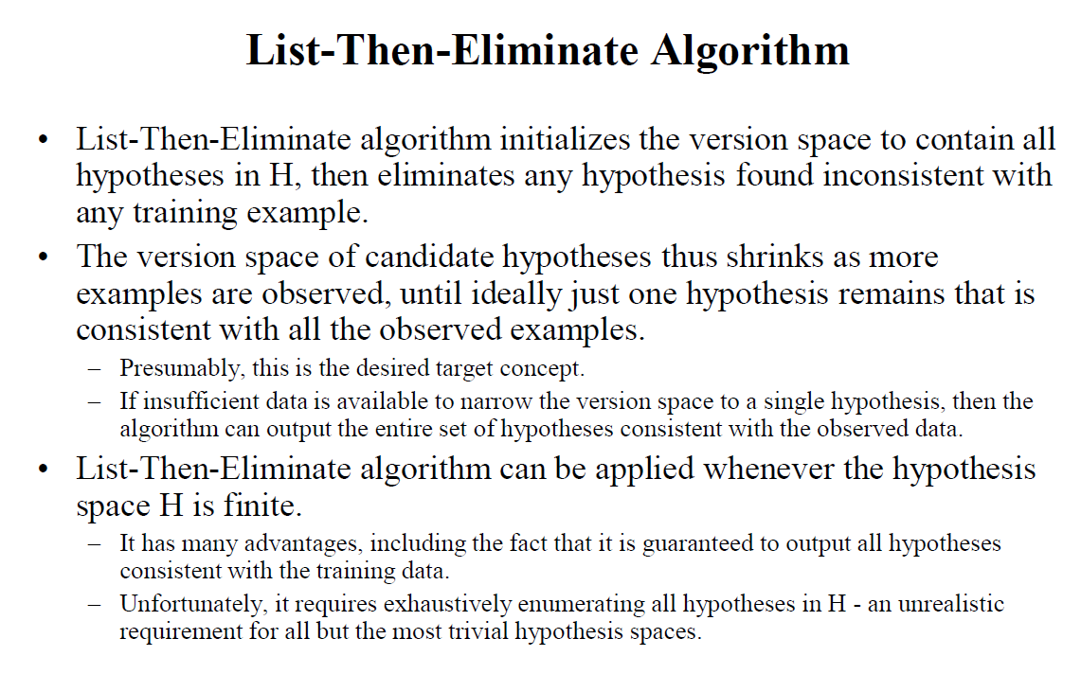
Concept Learning (CO1)

Slide 151
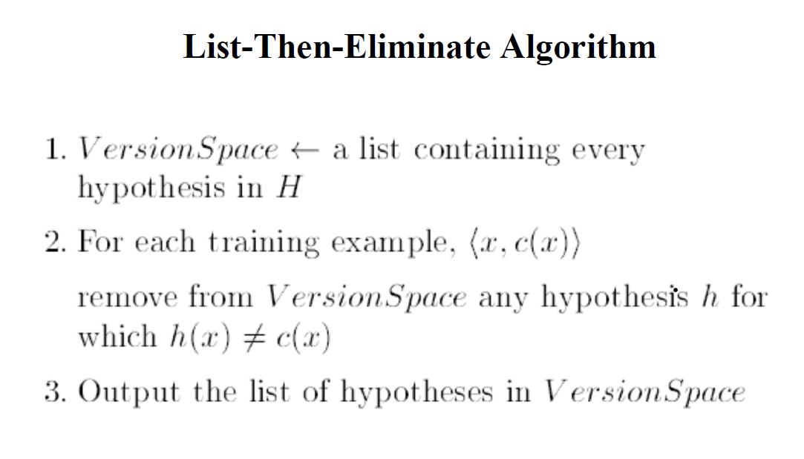
Concept Learning (CO1)

Slide 152
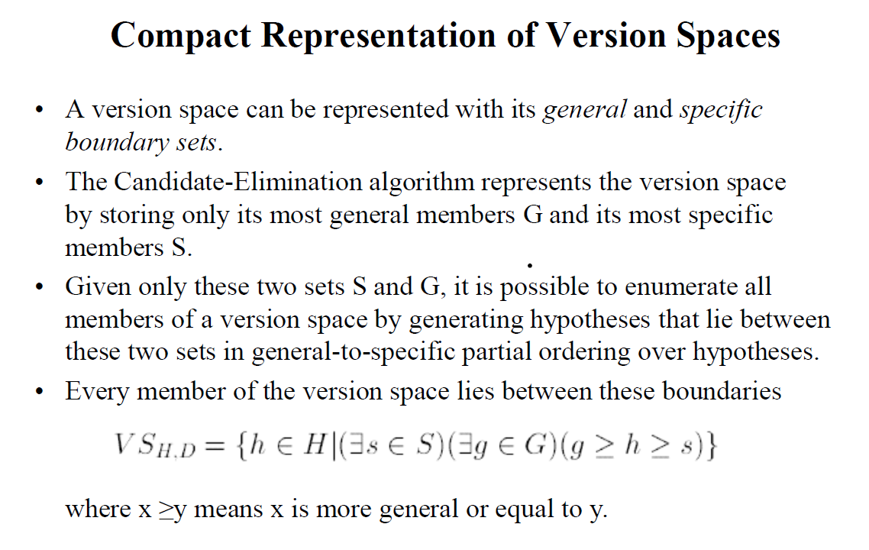
Concept Learning (CO1)

Slide 153
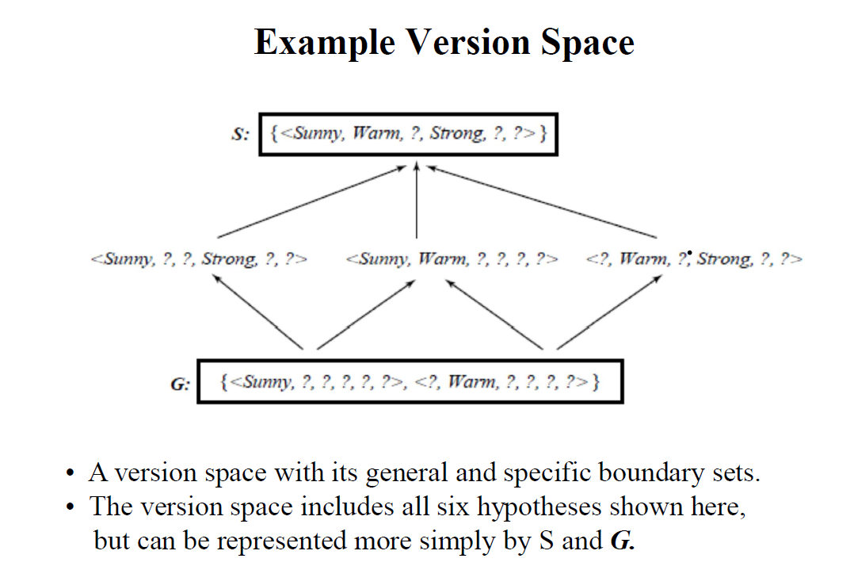
Concept Learning (CO1)

Slide 154
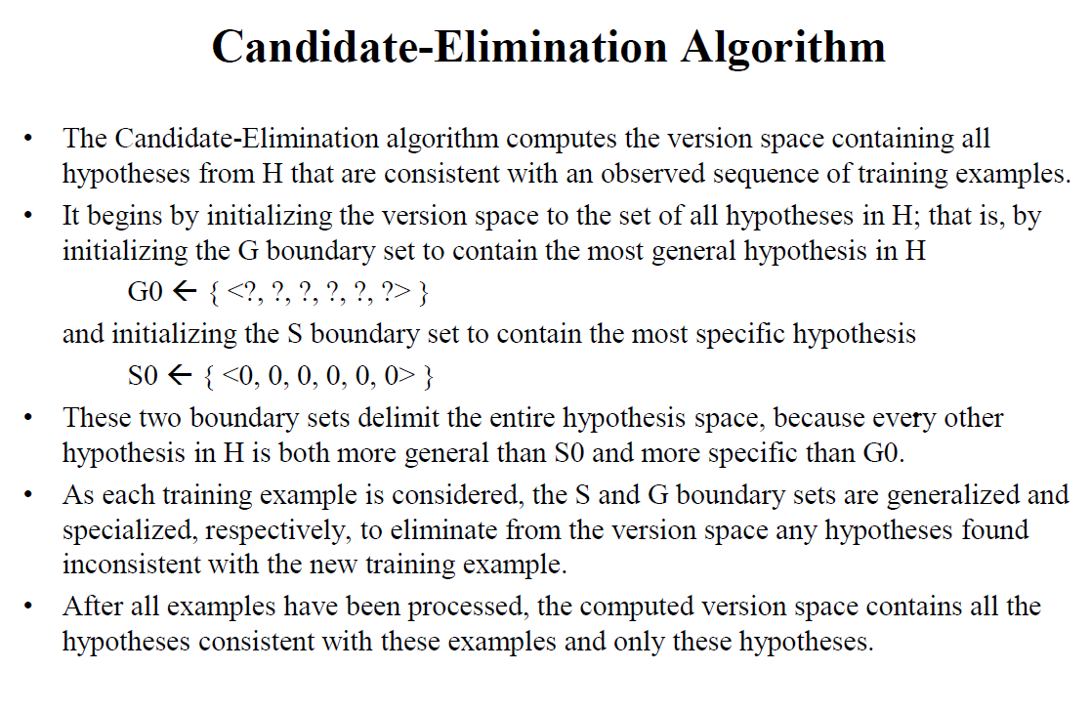
Concept Learning (CO1)

Slide 155
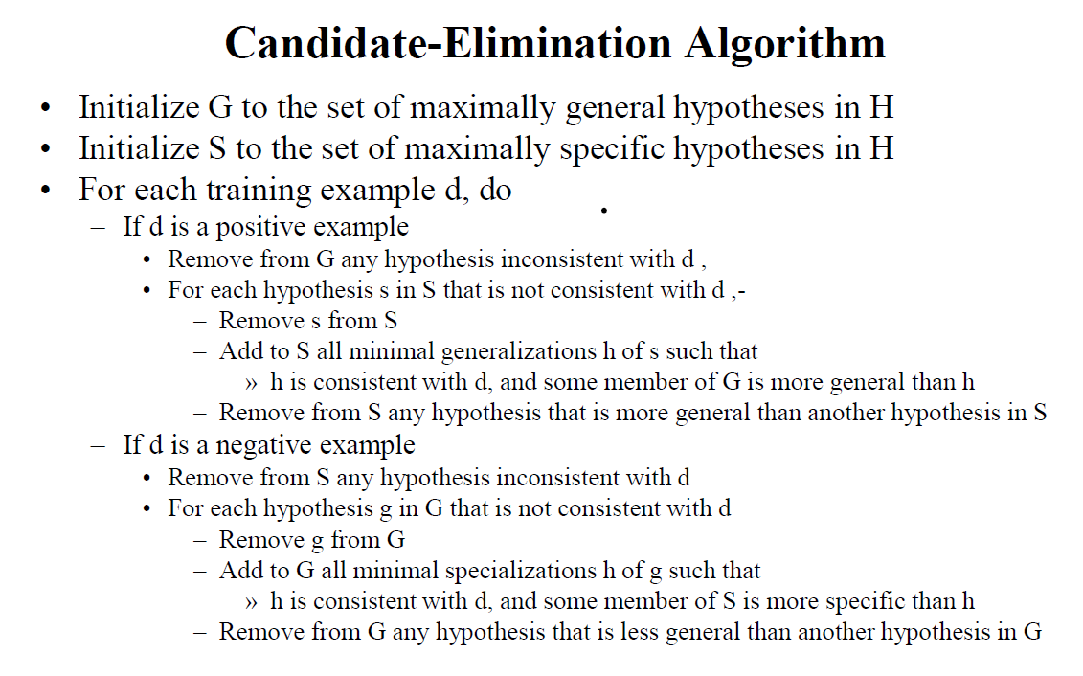
Concept Learning (CO1)

Slide 156
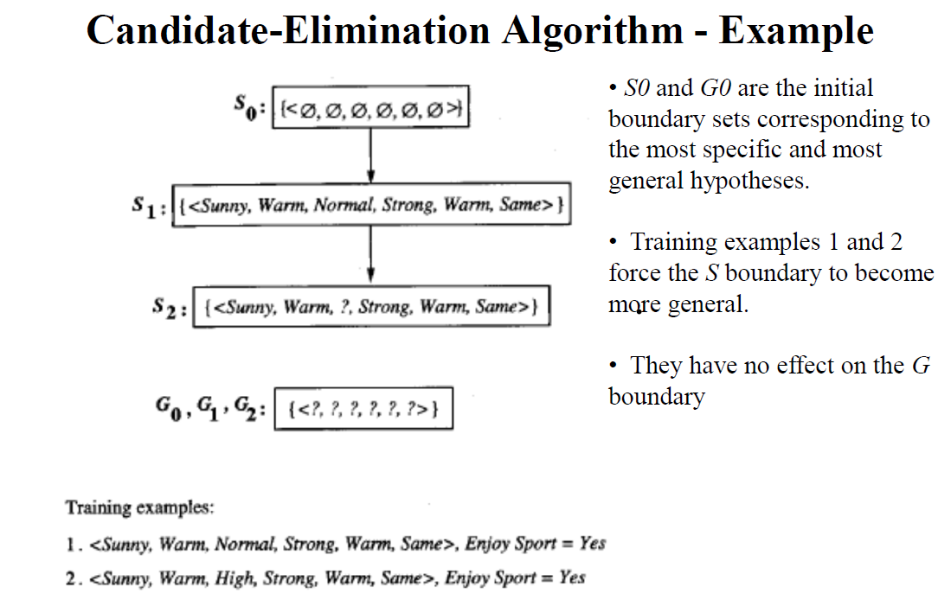
Concept Learning (CO1)

Slide 157

Concept Learning (CO1)

Slide 158

Concept Learning (CO1)

Slide 159

Concept Learning (CO1)

Slide 160

Concept Learning (CO1)

Slide 161

Concept Learning (CO1)

Slide 162

Concept Learning (CO1)

Slide 163

Concept Learning (CO1)

Slide 164

Concept Learning (CO1)

Slide 165

Concept Learning (CO1)

Slide 166

Concept Learning (CO1)

Slide 167

Concept Learning (CO1)

Slide 168

Concept Learning (CO1)

Slide 169

Concept Learning (CO1)

Slide 170

Concept Learning (CO1)

Slide 171

Concept Learning (CO1)

Slide 172

Concept Learning (CO1)

Slide 173

Concept Learning (CO1)

Slide 174

Concept Learning (CO1)

Slide 175

Concept Learning (CO1)

Slide 176

Concept Learning (CO1)

Slide 177

Concept Learning (CO1)

Slide 178

Concept Learning (CO1)

Slide 179
History of Machine Learning (CO1)
Computer machinery and intelligence:
1950: In 1950, Alan Turing published a seminal paper, "Computer Machinery and Intelligence," on the topic of artificial intelligence. In his paper, he asked, "Can machines think?"
Machine intelligence in Games:
1952: Arthur Samuel, who was the pioneer of machine learning, created a program that helped an IBM computer to play a checkers game. It performed better more it played.
1959: In 1959, the term "Machine Learning" was first coined by Arthur Samuel.
The first "AI" winter:
The duration of 1974 to 1980 was the tough time for AI and ML researchers, and this duration was called as AI winter.
In this duration, failure of machine translation occurred, and people had reduced their interest from AI, which led to reduced funding by the government to the researches.

Slide 180
History of Machine Learning (CO1)
Machine Learning from theory to reality
1959: In 1959, the first neural network was applied to a real-world problem to remove echoes over phone lines using an adaptive filter.
1985: In 1985, Terry Sejnowski and Charles Rosenberg invented a neural network NETtalk, which was able to teach itself how to correctly pronounce 20,000 words in one week.
1997: The IBM's Deep blue intelligent computer won the chess game against the chess expert Garry Kasparov, and it became the first computer which had beaten a human chess expert.

Slide 181
History of Machine Learning (CO1)
Machine Learning at 21st century
2006: In the year 2006, computer scientist Geoffrey Hinton has given a new name to neural net research as "deep learning," and nowadays, it has become one of the most trending technologies.
2012: In 2012, Google created a deep neural network which learned to recognize the image of humans and cats in YouTube videos.
2014: In 2014, the Chabot "Eugen Goostman" cleared the Turing Test. It was the first Chabot who convinced the 33% of human judges that it was not a machine.
2014: DeepFace was a deep neural network created by Facebook, and they claimed that it could recognize a person with the same precision as a human can do.
2016: AlphaGo beat the world's number second player Lee sedol at Go game. In 2017 it beat the number one player of this game Ke Jie.
2017: In 2017, the Alphabet's Jigsaw team built an intelligent system that was able to learn the online trolling. It used to read millions of comments of different websites to learn to stop online trolling.

Slide 182
History of Machine Learning (CO1)
Machine Learning at present:
Now machine learning has got a great advancement in its research, and it is present everywhere around us, such as self-driving cars, Amazon Alexa, Catboats, recommender system, and many more. It includes Supervised, unsupervised, and reinforcement learning with clustering, classification, decision tree, SVM algorithms, etc.
Modern machine learning models can be used for making various predictions, including weather prediction, disease prediction, stock market analysis, etc.

Slide 183
Introduction of Machine Learning Approaches(CO1,2,3,4)
A Neural Network
A neural network is a processing device, either an algorithm or an actual hardware, whose design was inspired by the design and functioning of animal brains and components thereof.
The neural networks have ability to learn by example, which makes them very flexible and powerful.
These networks are also well suited for real-time systems because of their fast response and computational times which are because of their parallel architecture.

Slide 184
Introduction of Machine Learning Approaches(CO1,2,3,4)
Artificial Neural Network: Definition:
An artificial neural network (ANN) may be defined as an information processing model that is inspired by the way biological nervous systems, such as the brain, process information.
This model tries to replicate only the most basic functions of the brain.
The key element of ANN is the novel structure of its information processing system.
An ANN is composed of a large number of highly interconnected processing elements (neurons) working in unison to solve specific problems.
Artificial neural networks, like people, learn by example.

Slide 185
Introduction of Machine Learning Approaches(CO1,2,3,4)
Advantages of Neural Networks:
Adaptive learning: An ANN is endowed with the ability to learn how to do tasks based on the data given for training or initial experience.
Self-organization: An ANN can create its own organization or representation of the information it receives during learning time.
Real-time operation: ANN computations may be carried out in parallel. Special hardware devices are being designed and manufactured to rake advantage of this capability of ANNs.
Fault tolerance via redundant information coding: Partial destruction of a neural network leads to the corresponding degradation of performance. However, some network capabilities may be retrained even after major network damage.

Slide 186

Introduction of Machine Learning Approaches(CO1,2,3,4)

Slide 187
Introduction of Machine Learning Approaches(CO1,2,3,4)
Application Scope of Neural Networks:
Air traffic control.
Animal behavior, predator/prey relationships and population cycles.
Appraisal and valuation of property, buildings, automobiles, machinery, etc.
Betting on horse races, stock markets, sporting events, etc.
Criminal sentencing could be predicted using a large sample of crime details as input and the resulting sentence as output.
Complex physical and chemical processes that may involve the interaction of numerous (possibly unknown) mathematical formulas could be modeled heuristically using a neural network.
Echo patterns from sonar, radar, seismic and magnetic instruments could be used to predict their targets.

Slide 188
Neural Networks (CO1, CO2, CO3)
An artificial neural network (ANN) is an efficient information processing system which resembles in characteristics with a biological neural network.
ANNs possess large number of highly interconnected processing elements called nodes or units or neuron, which usually operate in parallel and are configured in regular architectures.
Each neuron is connected with the other by a connection link.
Each connection link is associated with weights which contain information about input signals.
This information is used by the neuron to solve a particular problem.

Slide 189



Neural Networks (CO1, CO2, CO3)
To depict the basic operation of a neural net, consider a set of neurons, say X1 and X2, transmitting signals to another neuron, Y.
Here X1 and X2 are input neurons, which transmit signals, and Y is the output neuron, which receives signals.
Input neurons X1 and X2 are connected to the output neuron Y, over a weighted interconnection links (W1 and W2).
Activation Function

Slide 190

Biological Neural Networks (CO1, CO2, CO3)
A nerve cell neuron is a special biological cell that processes information.
According to an estimation, there are huge number of neurons, approximately 10¹¹ with numerous interconnections, approximately 10¹⁵.

Slide 191
Biological Neural Networks (CO1, CO2, CO3)
The central nervous system (which includes the brain and spinal cord) is made up of two basic types of cells:
neurons (1) and glia (4) & (6).
Glia outnumber neurons in some parts of the brain, but neurons are the key players in the brain.
Neurons are information messengers.
They use electrical impulses and chemical signals to transmit information between different areas of the brain, and between the brain and the rest of the nervous system.
Everything we think and feel and do would be impossible without the work of neurons and their support cells, the glial cells called astrocytes (4) and oligodendrocytes (6).

Slide 192

Biological Neural Networks (CO1, CO2, CO3)
The Architecture of Neuron

Slide 193
Biological Neural Networks (CO1, CO2, CO3)
Neurons have three basic parts: a cell body and two extensions called an axon (5) and a dendrite (3).
Within the cell body is a nucleus (2), which controls the cell’s activities and contains the cell’s genetic material.
The axon looks like a long tail and transmits messages from the cell.
Dendrites look like the branches of a tree and receive messages for the cell.
Neurons communicate with each other by sending chemicals, called neurotransmitters, across a tiny space, called a synapse, between the axons and dendrites of adjacent neurons.

Slide 194

Biological Neural Networks (CO1, CO2, CO3)
There are three classes of neurons:
Sensory neurons carry information from the sense organs (such as the eyes and ears) to the brain.
Motor neurons control voluntary muscle activity such as speaking and carry messages from nerve cells in the brain to the muscles.
All the other neurons are called interneurons.

Slide 195
Biological Neural Networks (CO1, CO2, CO3)
As shown in the above diagram, a typical neuron consists of the following four parts with the help of which we can explain its working −
Dendrites − They are tree-like branches, responsible for receiving the information from other neurons it is connected to. In other sense, we can say that they are like the ears of neuron.
Soma − It is the cell body of the neuron and is responsible for processing of information, they have received from dendrites.
Axon − It is just like a cable through which neurons send the information.
Synapses − It is the connection between the axon and other neuron dendrites.

Slide 196

Biological Neural Networks (CO1, CO2, CO3)

Slide 197

Biological Neural Networks (CO1, CO2, CO3)
Biological Neural Network | Artificial Neural Network
Soma | Node
Dendrites | Input
Synapse | Weights or Interconnections
Axon | Output

Slide 198

Biological Neural Networks(CO1, CO2, CO3)
a

Slide 199

Artificial Neural Networks(CO1, CO2, CO3)

Slide 200

Artificial Neural Networks(CO1, CO2, CO3)

Slide 201


Model of ANN (CO1, CO2, CO3)

Slide 202
Neural Networks (CO1, CO2, CO3)
Characteristics of ANN:
It is a neutrally implemented mathematical model.
There exists a large number of highly interconnected processing elements called neurons in an ANN.
The interconnections with their weighted linkages hold the informative knowledge.
The input signals arrive at the processing elements through connections and connecting weights.
The processing elements of the ANN have the ability to learn, recall and generalize from the given data by suitable assignment or adjustment of weights.
The computational power can be demonstrated only by the collective behavior of neurons, and it should be noted that no single neuron carries specific information.

Slide 203
Introduction of Machine Learning Approaches(CO1,2,3,4)
Introduction to Clustering
Clustering methods are one of the most useful unsupervised ML methods. These methods are used to find similarity as well as the relationship patterns among data samples and then cluster those samples into groups having similarity based on features.
Clustering is important because it determines the intrinsic grouping among the present unlabeled data. They basically make some assumptions about data points to constitute their similarity. Each assumption will construct different but equally valid clusters.

Slide 204

Introduction of Machine Learning Approaches(CO1,2,3,4)
For example, below is the diagram which shows clustering system grouped together with the similar kind of data in different clusters −

Slide 205
Introduction of Machine Learning Approaches(CO1,2,3,4)
Cluster Formation Methods
It is not necessary that clusters will be formed in spherical form. Followings are some other cluster formation methods −
Density-based
In these methods, the clusters are formed as the dense region. The advantage of these methods is that they have good accuracy as well as good ability to merge two clusters. Ex. Density-Based Spatial Clustering of Applications with Noise (DBSCAN), Ordering Points to identify Clustering structure (OPTICS) etc.
Hierarchical-based
In these methods, the clusters are formed as a tree type structure based on the hierarchy. They have two categories namely, Agglomerative (Bottom up approach) and Divisive (Top down approach). Ex. Clustering using Representatives (CURE), Balanced iterative Reducing Clustering using Hierarchies (BIRCH) etc.
Partitioning
In these methods, the clusters are formed by portioning the objects into k clusters. Number of clusters will be equal to the number of partitions. Ex. K-means, Clustering Large Applications based upon randomized Search (CLARANS).
Grid
In these methods, the clusters are formed as a grid like structure. The advantage of these methods is that all the clustering operation done on these grids are fast and independent of the number of data objects. Ex. Statistical Information Grid (STING), Clustering in Quest (CLIQUE).

Slide 206
Introduction of Machine Learning Approaches(CO1,2,3,4)
Types of ML Clustering Algorithms
The following are the most important and useful ML clustering algorithms −
K-means Clustering
This clustering algorithm computes the centroids and iterates until it finds optimal centroid. It assumes that the number of clusters are already known. It is also called flat clustering algorithm. The number of clusters identified from data by algorithm is represented by ‘K’ in K-means.
Mean-Shift Algorithm
It is another powerful clustering algorithm used in unsupervised learning. Unlike K-means clustering, it does not make any assumptions hence it is a non-parametric algorithm.
Hierarchical Clustering
It is another unsupervised learning algorithm that is used to group together the unlabeled data points having similar characteristics.

Slide 207
Introduction of Machine Learning Approaches(CO1,2,3,4)
Applications of Clustering
We can find clustering useful in the following areas −
Data summarization and compression − Clustering is widely used in the areas where we require data summarization, compression and reduction as well. The examples are image processing and vector quantization.
Collaborative systems and customer segmentation − Since clustering can be used to find similar products or same kind of users, it can be used in the area of collaborative systems and customer segmentation.
Serve as a key intermediate step for other data mining tasks − Cluster analysis can generate a compact summary of data for classification, testing, hypothesis generation; hence, it serves as a key intermediate step for other data mining tasks also.
Trend detection in dynamic data − Clustering can also be used for trend detection in dynamic data by making various clusters of similar trends.
Social network analysis − Clustering can be used in social network analysis. The examples are generating sequences in images, videos or audios.
Biological data analysis − Clustering can also be used to make clusters of images, videos hence it can successfully be used in biological data analysis.

Slide 208

Introduction of Machine Learning Approaches(CO1,2,3,4)
Reinforcement learning
Reinforcement learning is an area of Machine Learning.
It is about taking suitable action to maximize reward in a particular situation.
It is employed by various software and machines to find the best possible behavior or path it should take in a specific situation.
Reinforcement learning differs from the supervised learning in a way that in supervised learning the training data has the answer key with it so the model is trained with the correct answer itself whereas in reinforcement learning, there is no answer but the reinforcement agent decides what to do to perform the given task.
In the absence of a training dataset, it is bound to learn from its experience.

Slide 209

Introduction of Machine Learning Approaches(CO1,2,3,4)
Reinforcement learning
Dr. Hitesh Singh KCS 055 ML Unit 1

Slide 210

Introduction of Machine Learning Approaches(CO1,2,3,4)
Example: The problem is as follows: We have an agent and a reward, with many hurdles in between. The agent is supposed to find the best possible path to reach the reward. The following problem explains the problem more easily.

Slide 211

Introduction of Machine Learning Approaches(CO1,2,3,4)

Slide 212

Introduction of Machine Learning Approaches(CO1,2,3,4)

Slide 213

Introduction of Machine Learning Approaches(CO1,2,3,4)

Slide 214

Introduction of Machine Learning Approaches(CO1,2,3,4)

Slide 215

Introduction of Machine Learning Approaches(CO1,2,3,4)

Slide 216

Introduction of Machine Learning Approaches(CO1,2,3,4)

Slide 217
Introduction of Machine Learning Approaches(CO1,2,3,4)
Main points in Reinforcement learning –
Input: The input should be an initial state from which the model will start
Output: There are many possible output as there are variety of solution to a particular problem
Training: The training is based upon the input, The model will return a state and the user will decide to reward or punish the model based on its output.
The model keeps continues to learn.
The best solution is decided based on the maximum reward.

Slide 218
Introduction of Machine Learning Approaches(CO1,2,3,4)
Reinforcement learning | Supervised learning
Reinforcement learning is all about making decisions sequentially. In simple words we can say that the output depends on the state of the current input and the next input depends on the output of the previous input | In Supervised learning the decision is made on the initial input or the input given at the start
In Reinforcement learning decision is dependent, So we give labels to sequences of dependent decisions | Supervised learning the decisions are independent of each other so labels are given to each decision.
Example: Chess game | Example: Object recognition

Slide 219
Introduction of Machine Learning Approaches(CO1,2,3,4)
Various Practical applications of Reinforcement Learning –
RL can be used in robotics for industrial automation.
RL can be used in machine learning and data processing
RL can be used to create training systems that provide custom instruction and materials according to the requirement of students.
RL can be used in large environments in the following situations:
A model of the environment is known, but an analytic solution is not available;
Only a simulation model of the environment is given (the subject of simulation-based optimization)
The only way to collect information about the environment is to interact with it.

Slide 220
Introduction of Machine Learning Approaches(CO1,2,3,4)
Decision Tree :
Decision Tree is a Supervised learning technique that can be used for both classification and Regression problems, but mostly it is preferred for solving Classification problems. It is a tree-structured classifier, where internal nodes represent the features of a dataset, branches represent the decision rules and each leaf node represents the outcome.
In a Decision tree, there are two nodes, which are the Decision Node and Leaf Node. Decision nodes are used to make any decision and have multiple branches, whereas Leaf nodes are the output of those decisions and do not contain any further branches.
The decisions or the test are performed on the basis of features of the given dataset.

Slide 221
Introduction of Machine Learning Approaches(CO1,2,3,4)
It is a graphical representation for getting all the possible solutions to a problem/decision based on given conditions.
It is called a decision tree because, similar to a tree, it starts with the root node, which expands on further branches and constructs a tree-like structure.
In order to build a tree, we use the CART algorithm, which stands for Classification and Regression Tree algorithm.
A decision tree simply asks a question, and based on the answer (Yes/No), it further split the tree into subtrees.

Slide 222

Introduction of Machine Learning Approaches(CO1,2,3,4)

Slide 223

Introduction of Machine Learning Approaches(CO1,2,3,4)

Slide 224

Introduction of Machine Learning Approaches(CO1,2,3,4)

Slide 225
Introduction of Machine Learning Approaches(CO1,2,3,4)
Why use Decision Trees?
There are various algorithms in Machine learning, so choosing the best algorithm for the given dataset and problem is the main point to remember while creating a machine learning model. Below are the two reasons for using the Decision tree:
Decision Trees usually mimic human thinking ability while making a decision, so it is easy to understand.
The logic behind the decision tree can be easily understood because it shows a tree-like structure.

Slide 226
Introduction of Machine Learning Approaches(CO1,2,3,4)
Decision Tree Terminologies:
Root Node: Root node is from where the decision tree starts. It represents the entire dataset, which further gets divided into two or more homogeneous sets.
Leaf Node: Leaf nodes are the final output node, and the tree cannot be segregated further after getting a leaf node.
Splitting: Splitting is the process of dividing the decision node/root node into sub-nodes according to the given conditions.
Branch/Sub Tree: A tree formed by splitting the tree.
Pruning: Pruning is the process of removing the unwanted branches from the tree.
Parent/Child node: The root node of the tree is called the parent node, and other nodes are called the child nodes.

Slide 227
Introduction of Machine Learning Approaches(CO1,2,3,4)
How does the Decision Tree algorithm Work?
In a decision tree, for predicting the class of the given dataset, the algorithm starts from the root node of the tree. This algorithm compares the values of root attribute with the record (real dataset) attribute and, based on the comparison, follows the branch and jumps to the next node.
For the next node, the algorithm again compares the attribute value with the other sub-nodes and move further. It continues the process until it reaches the leaf node of the tree. The complete process can be better understood using the below algorithm:
Step-1: Begin the tree with the root node, says S, which contains the complete dataset.
Step-2: Find the best attribute in the dataset using Attribute Selection Measure (ASM).
Step-3: Divide the S into subsets that contains possible values for the best attributes.
Step-4: Generate the decision tree node, which contains the best attribute.
Step-5: Recursively make new decision trees using the subsets of the dataset created in step -3. Continue this process until a stage is reached where you cannot further classify the nodes and called the final node as a leaf node.

Slide 228

Introduction of Machine Learning Approaches(CO1,2,3,4)

Slide 229
Introduction of Machine Learning Approaches(CO1,2,3,4)
Bayesian networks:
Bayesian networks are a type of Probabilistic Graphical Model that can be used to build models from data and/or expert opinion.
They can be used for a wide range of tasks including prediction, anomaly detection, diagnostics, automated insight, reasoning, time series prediction and decision making under uncertainty.
Figure below shows these capabilities in terms of the four major analytics disciplines, Descriptive analytics, Diagnostic analytics, Predictive analytics and Prescriptive analytics.

Slide 230

Introduction of Machine Learning Approaches(CO1,2,3,4)
Bayesian networks:

Slide 231

Introduction of Machine Learning Approaches(CO1,2,3,4)
Bayesian networks:
They are also commonly referred to as Bayes nets, Belief networks and sometimes Causal networks.
Probabilistic
Bayesian networks are probabilistic (conditional probability) because they are built from probability distributions and also use the laws of probability for prediction and anomaly detection, for reasoning and diagnostics, decision making under uncertainty and time series prediction.

Slide 232

Introduction of Machine Learning Approaches(CO1,2,3,4)

Slide 233
Introduction of Machine Learning Approaches(CO1,2,3,4)
A Bayesian network is a (DAG) graph which is made up of Nodes and directed Links between them.
Nodes
In many Bayesian networks, each node represents a Variable such as someone's height, age or gender. A variable might be discrete, such as Gender = {Female, Male} or might be continuous such as someone's age.
The nodes and links form the structure of the Bayesian network, and we call this the structural specification.
Bayes Server supports both discrete and continuous variables.
Discrete
A discrete variable is one with a set of mutually exclusive states such as Gender = {Female, Male}.
Continuous
Bayes Server support continuous variables with Conditional Linear Gaussian distributions (CLG). This simply means that continuous distributions can depend on each other (are multivariate) and can also depend on one or more discrete variables.

Slide 234

Introduction of Machine Learning Approaches(CO1,2,3,4)
Bayesian networks:

Slide 235
Introduction of Machine Learning Approaches(CO1,2,3,4)
Links
Links are added between nodes to indicate that one node directly influences the other. When a link does not exist between two nodes, this does not mean that they are completely independent, as they may be connected via other nodes. They may however become dependent or independent depending on the evidence that is set on other nodes.
Structural learning
Bayes Server include a Structural learning algorithm for Bayesian networks, which can automatically determine the required links from data.
Feature selection
Bayes Server supports a Feature selection algorithm which can help determine which variables are most likely to influence another. This can be helpful when determining the structure of a model.
https://www.bayesserver.com/docs/introduction/bayesian-networks

Slide 236
Introduction of Machine Learning Approaches(CO1,2,3,4)
Introduction to SVM
Support vector machines (SVMs) are powerful yet flexible supervised machine learning algorithms which are used both for classification and regression.
But generally, they are used in classification problems.
In 1960s, SVMs were first introduced but later they got refined in 1990.
SVMs have their unique way of implementation as compared to other machine learning algorithms.
Lately, they are extremely popular because of their ability to handle multiple continuous and categorical variables.

Slide 237
Introduction of Machine Learning Approaches(CO1,2,3,4)
Generally, Support Vector Machines is considered to be a classification approach, it but can be employed in both types of classification and regression problems.
It can easily handle multiple continuous and categorical variables.
SVM constructs a hyperplane in multidimensional space to separate different classes.
SVM generates optimal hyperplane in an iterative manner, which is used to minimize an error.
The core idea of SVM is to find a maximum marginal hyperplane(MMH) that best divides the dataset into classes.

Slide 238

Introduction of Machine Learning Approaches(CO1,2,3,4)

Slide 239
Introduction of Machine Learning Approaches(CO1,2,3,4)
Support Vectors
Support vectors are the data points, which are closest to the hyperplane. These points will define the separating line better by calculating margins. These points are more relevant to the construction of the classifier.
Hyperplane
A hyperplane is a decision plane which separates between a set of objects having different class memberships.
Margin
A margin is a gap between the two lines on the closest class points. This is calculated as the perpendicular distance from the line to support vectors or closest points. If the margin is larger in between the classes, then it is considered a good margin, a smaller margin is a bad margin.

Slide 240

Introduction of Machine Learning Approaches(CO1,2,3,4)

Slide 241
Introduction of Machine Learning Approaches(CO1,2,3,4)
How does SVM work?
The main objective is to segregate the given dataset in the best possible way.
The distance between the either nearest points is known as the margin.
The objective is to select a hyperplane with the maximum possible margin between support vectors in the given dataset.
SVM searches for the maximum marginal hyperplane in the following steps:
Generate hyperplanes which segregates the classes in the best way. Figure showing three hyperplanes black, blue and orange. Here, the blue and orange have higher classification error, but the black is separating the two classes correctly.
Select the right hyperplane with the maximum segregation from the either nearest data points as shown in the right-hand side figure.

Slide 242

Introduction of Machine Learning Approaches(CO1,2,3,4)

Slide 243
Introduction of Machine Learning Approaches(CO1,2,3,4)
Dealing with non-linear and inseparable planes
Some problems can’t be solved using linear hyperplane, as shown in the figure below (left-hand side).
In such situation, SVM uses a kernel trick to transform the input space to a higher dimensional space as shown on the right. The data points are plotted on the x-axis and z-axis (Z is the squared sum of both x and y: z=x^2=y^2). Now you can easily segregate these points using linear separation.

Slide 244

Introduction of Machine Learning Approaches(CO1,2,3,4)

Slide 245

Introduction of Machine Learning Approaches(CO1,2,3,4)

Slide 246

Introduction of Machine Learning Approaches(CO1,2,3,4)

Slide 247
Introduction of Machine Learning Approaches(CO1,2,3,4)
SVM Kernels
The SVM algorithm is implemented in practice using a kernel.
A kernel transforms an input data space into the required form.
SVM uses a technique called the kernel trick. Here, the kernel takes a low-dimensional input space and transforms it into a higher dimensional space.
In other words, you can say that it converts no separable problem to separable problems by adding more dimension to it.
It is most useful in non-linear separation problem.

Slide 248
Introduction of Machine Learning Approaches(CO1,2,3,4)
Types of Kernel:
Linear Kernel: A linear kernel can be used as normal dot product any two given observations. The product between two vectors is the sum of the multiplication of each pair of input values.
K(x, xi) = sum(x * xi)
Polynomial Kernel: A polynomial kernel is a more generalized form of the linear kernel. The polynomial kernel can distinguish curved or nonlinear input space.
K(x,xi) = 1 + sum(x * xi)^d
Where d is the degree of the polynomial. d=1 is similar to the linear transformation. The degree needs to be manually specified in the learning algorithm.

Slide 249
Introduction of Machine Learning Approaches(CO1,2,3,4)
Types of Kernel:
Linear Kernel: A linear kernel can be used as normal dot product any two given observations. The product between two vectors is the sum of the multiplication of each pair of input values.
K(x, xi) = sum(x * xi)
Polynomial Kernel: A polynomial kernel is a more generalized form of the linear kernel. The polynomial kernel can distinguish curved or nonlinear input space.
K(x,xi) = 1 + sum(x * xi)^d
Where d is the degree of the polynomial. d=1 is similar to the linear transformation. The degree needs to be manually specified in the learning algorithm.

Slide 250
Introduction of Machine Learning Approaches(CO1,2,3,4)
Radial Basis Function Kernel: The Radial basis function kernel is a popular kernel function commonly used in support vector machine classification. RBF can map an input space in infinite dimensional space.
K(x,xi) = exp(-gamma * sum((x – xi^2))
Here gamma is a parameter, which ranges from 0 to 1. A higher value of gamma will perfectly fit the training dataset, which causes over-fitting. Gamma=0.1 is considered to be a good default value. The value of gamma needs to be manually specified in the learning algorithm.

Slide 251

Introduction of Machine Learning Approaches(CO1,2,3,4)

Slide 252

Introduction of Machine Learning Approaches(CO1,2,3,4)

Slide 253

Introduction of Machine Learning Approaches(CO1,2,3,4)
Genetic Algorithms – Introduction
Genetic Algorithm (GA) is a search-based optimization technique based on the principles of Genetics and Natural Selection.
It is frequently used to find optimal or near-optimal solutions to difficult problems which otherwise would take a lifetime to solve.
It is frequently used to solve optimization problems, in research, and in machine learning.

Slide 254

Introduction of Machine Learning Approaches(CO1,2,3,4)

Slide 255
Introduction of Machine Learning Approaches(CO1,2,3,4)
What are Genetic Algorithms?
Nature has always been a great source of inspiration to all mankind.
Genetic Algorithms (GAs) are search based algorithms based on the concepts of natural selection and genetics.
GAs are a subset of a much larger branch of computation known as Evolutionary Computation.
GAs were developed by John Holland and his students and colleagues at the University of Michigan, most notably David E. Goldberg and has since been tried on various optimization problems with a high degree of success.

Slide 256

Introduction of Machine Learning Approaches(CO1,2,3,4)
What are Genetic Algorithms?
In GAs, we have a pool or a population of possible solutions to the given problem.
These solutions then undergo recombination and mutation (like in natural genetics), producing new children, and the process is repeated over various generations.
Each individual (or candidate solution) is assigned a fitness value (based on its objective function value) and the fitter individuals are given a higher chance to mate and yield more “fitter” individuals.
This is in line with the Darwinian Theory of “Survival of the Fittest”.
In this way we keep “evolving” better individuals or solutions over generations, till we reach a stopping criterion.
Genetic Algorithms are sufficiently randomized in nature, but they perform much better than random local search (in which we just try various random solutions, keeping track of the best so far), as they exploit historical information as well.

Slide 257


Introduction of Machine Learning Approaches(CO1,2,3,4)

Slide 258
Introduction of Machine Learning Approaches(CO1,2,3,4)
Advantages of GAs
Does not require any derivative information (which may not be available for many real-world problems).
Is faster and more efficient as compared to the traditional methods.
Has very good parallel capabilities.
Optimizes both continuous and discrete functions and also multi-objective problems.
Provides a list of “good” solutions and not just a single solution.
Always gets an answer to the problem, which gets better over the time.
Useful when the search space is very large and there are a large number of parameters involved.

Slide 259
Introduction of Machine Learning Approaches(CO1,2,3,4)
Limitations of GAs
GAs are not suited for all problems, especially problems which are simple and for which derivative information is available.
Fitness value is calculated repeatedly which might be computationally expensive for some problems.
Being stochastic, there are no guarantees on the optimality or the quality of the solution.
If not implemented properly, the GA may not converge to the optimal solution.

Slide 260
Data Science Vs. Machine Learning and AI
(CO1,2,3,4)
Artificial Intelligence | Machine Learning | Data Science
Includes Machine Learning. | Subset of Artificial Intelligence. | Includes various Data Operations.
Artificial Intelligence combines large amounts of data through iterative processing and intelligent algorithms to help computers learn automatically. | Machine Learning uses efficient programs that can use data without being explicitly told to do so. | Data Science works by sourcing, cleaning, and processing data to extract meaning out of it for analytical purposes.
Some of the popular tools that AI uses are- 1. TensorFlow2. Scikit Learn 3. Keras | The popular tools that Machine Learning makes use of are-1. Amazon Lex2. IBM Watson Studio3. Microsoft Azure ML Studio | Some of the popular tools used by Data Science are-1. SAS2. Tableau3. Apache Spark4. MATLAB
Artificial Intelligence uses logic and decision trees. | Machine Learning uses statistical models. | Data Science deals with structured and unstructured data.
Chatbots, and Voice assistants are popular applications of AI. | Recommendation Systems such as Spotify, and Facial Recognition are popular examples. | Fraud Detection and Healthcare analysis are popular examples of Data Science.

Slide 261
Assignment 1:
Define Machine Learning. Discuss with examples why machine learning is important.
Discuss with examples some useful applications of machine learning.
Explain how some areas/disciplines that influenced the machine learning.
What do you mean by a well–posed learning problem? Explain the important features that are required to well–define a learning problem.
Define learning program for a given problem. Describe the following problems with respect to Tasks, Performance and Experience:
a. Checkers Learning Problems
b. Handwritten Recognition Problem
c. Robot Driving Learning Problem
6. Describe in detail all the steps involved in designing a learning system.
7. Discuss the perspective and issues in machine learning.
NOTE: All Students have to write this assignment in separate note book.

Slide 262
Assignment 2:
What is Artificial Neural Network?
What are the type of problems in which Artificial Neural Network can be applied?
What is difference between BNN and ANN ?
Explain the k-Means Algorithm with an example.
What is Reinforcement Learning? Explain with the help of example.
Explain Bayesian networks with the help of Examples.
Explain Support Vector Machine in details. Describe their importance.
Explain Genetic Algorithms in details.

Slide 263
Daily Quiz
1. What is the main task of a problem-solving agent? a) Solve the given problem and reach to goal b) To find out which sequence of action will get it to the goal state c) All of the mentioned d) None of the mentioned
2. What is state space? a) The whole problem b) Your Definition to a problem c) Problem you design d) Representing your problem with variable and parameter

Slide 264
Daily Quiz
3. The problem-solving agent with several immediate options of unknown value can decide what to do by just examining different possible sequences of actions that lead to states of known value, and then choosing the best sequence. This process of looking for such a sequence is called Search. a) True b) False
4. A search algorithm takes _________ as an input and returns ________ as an output. a) Input, output b) Problem, solution c) Solution, problem d) Parameters, sequence of actions

Slide 265
Daily Quiz
5. A problem in a search space is defined by one of these state. a) Initial state b) Last state c) Intermediate state d) All of the mentioned
6. The Set of actions for a problem in a state space is formulated by a ___________ a) Intermediate states b) Initial state c) Successor function, which takes current action and returns next immediate state d) None of the mentioned

Slide 266
Glossary Questions
1. A solution to a problem is a ……………from the initial state to a goal state. Solution quality is measured by the path cost function, and an optimal solution has the highest path cost among all solutions. a) Path b) Road 2. The process of removing detail from a given state representation is called ______ a) Extraction b) Abstraction c) Information Retrieval d) Mining of data

Slide 267
Glossary Questions
3. A problem solving approach works well for ______________ a) 8-Puzzle problem b) 8-queen problem c) Finding a optimal path from a given source to a destination d) Mars Hover (Robot Navigation) 4. The _______ is a touring problem in which each city must be visited exactly once. The aim is to find the shortest tour. a) Finding shortest path between a source and a destination b) Travelling Salesman problem c) Map coloring problem d) Depth first search traversal on a given map represented as a graph

Slide 268
MCQ
1. Web Crawler is a/an ____________ a) Intelligent goal-based agent b) Problem-solving agent c) Simple reflex agent d) Model based agent 2. What is the major component/components for measuring the performance of problem solving? a) Completeness b) Optimality c) Time and Space complexity d) All of the mentioned

Slide 269
MCQ
3. A production rule consists of ____________ a) A set of Rule b) A sequence of steps c) Set of Rule & sequence of steps d) Arbitrary representation to problem 4. Which search method takes less memory? a) Depth-First Search b) Breadth-First search c) Linear Search d) Optimal search

Slide 270
MCQ
5. Which is the best way to go for Game playing problem? a) Linear approach b) Heuristic approach (Some knowledge is stored) c) Random approach d) An Optimal approach 6. Which of the following applications include in the Strategic Computing Program? a) battle management b) autonomous systems c) pilot’s associate d) all of the mentioned

Slide 271
MCQ
7. How many things are concerned in the design of a learning element? a) 1 b) 2 c) 3 d) 4 8. What is used in determining the nature of the learning problem? a) Environment b) Feedback c) Problem d) All of the mentioned

Slide 272
MCQ
9. How many types are available in machine learning? a) 1 b) 2 c) 3 d) 4 10. Which is used for utility functions in game playing algorithm? a) Linear polynomial b) Weighted polynomial c) Polynomial d) Linear weighted polynomial

Slide 273
Faculty Video Links, Youtube & NPTEL Video Links and Online Courses Details
Youtube video-
https://www.youtube.com/watch?v=PDYfCkLY_DE
https://www.youtube.com/watch?v=ncOirIPHTOw
https://www.youtube.com/watch?v=cW03t3aZkmE

Slide 274
Weekly Assignment
Assignment 1
Describe Machine Learning with suitable examples.[CO1]
Brief the well defined learning problems. [CO1]
Define the process of Designing a Learning System? [CO1]
Explain different perspective and Issues in Machine Learning. [CO1]
Define hypotheses. [CO1]
Analyze THE CONCEPT LEARNING TASK - General-to-specific ordering of hypotheses? [CO1]
Illustrate Find-S algorithm. [CO1]
Describe List-Then-Eliminate algorithm. [CO1]
Define Candidate elimination algorithm with example. [CO1]
Briefly explain Inductive bias. [CO1]

Slide 275

Old Question Papers

Slide 276

Old Question Papers

Slide 277
Expected Questions for University Exam
Illustrate Find-S algorithm. [CO1]
Describe List-Then-Eliminate algorithm. [CO1]
Define Candidate elimination algorithm with example. [CO1]
Briefly explain Inductive bias. [CO1]
Describe Machine Learning with suitable examples.[CO1]
Brief the well defined learning problems. [CO1]
Define the process of Designing a Learning System? [CO1]
Explain different perspective and Issues in Machine Learning. [CO1]
Define hypotheses. [CO1]
Analyze THE CONCEPT LEARNING TASK - General-to-specific ordering of hypotheses? [CO1]

Slide 278
References
Text books:
1. Tom M. Mitchell, ―Machine Learning, McGraw-Hill Education (India) Private Limited, 2013.
2. Ethem Alpaydin, ―Introduction to Machine Learning (Adaptive Computation and Machine Learning), The MIT Press 2004.
3. Stephen Marsland, ―Machine Learning: An Algorithmic Perspective, CRC Press, 2009.
4. Bishop, C., Pattern Recognition and Machine Learning. Berlin: Springer-Verlag.

Slide 279
Recap of Unit
Concept learning can be seen as a problem of searching through a large predefined space of potential hypotheses.
The general-to-specific partial ordering of hypotheses provides a useful structure for organizing the search through the hypothesis space.
The FIND-S algorithm utilizes this general-to-specific ordering, performing a specific-to-general search through the hypothesis space along one branch of the partial ordering, to find the most specific hypothesis consistent with the training examples.

